Slide 1
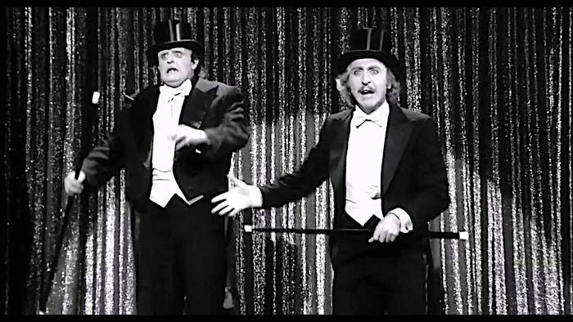
FERC’s RTO Frankenstein is more trick than treat
It’s Time For FERC To Put On a Top Hat, Sing Putting On the Ritz, And Actually Allow The Public Interest A Seat At The Table

Slide 2
The Only Way RTOs Can Deliver Treats For Consumers Is To Stop The Tricks They Use That Deny The Public Interest Meaningful Opportunity To Participate Public Citizen’s Five Point Reform Plan

Slide 3
In 1996, FERC Order 888 suggested the concept of an Independent System Operator as one way to satisfy the requirement of providing non-discriminatory access to transmission.
In December 1999, FERC Order 2000 encouraged the voluntary creation of ISOs/RTOs to “facilitate lighter handed regulation” so that ISOs/RTOs “would reduce the need for Commission oversight and scrutiny.” Membership must be voluntary because Congress has never explicitly authorized them. RTOs are an administrative creation of FERC.
(Order 2000, at pages 3 and 96, www.ferc.gov/legal/maj-ord-reg/land-docs/RM99-2A.pdf)

Slide 4
FERC Has Allowed ISOs/RTOs To Privatize Electricity Policy Making
FERC has delegated the heavy lifting of designing energy markets to the private RTOs. The RTOs (other than CAISO) administer internal stakeholder processes where lobbyists for utilities, power plants and Wall Street energy traders are free to not only offer their market design proposals but are granted voting rights by the RTO.
It is therefore unsurprising that RTOs pursue market designs that are hostile to renewables and the public interest.
RTOs are responsive to their members, not the public interest.

Slide 5
FERC & Courts Rely On The (incorrect) Assumption That the RTO Stakeholder Process Is Inclusive And Represent All Interests
NRG Power Marketing, LLC v. FERC (2017) limits FERC’s ability to alter RTOs § 205 filings, thereby vastly empowering the ability of RTOs to dictate the direction of market reforms. The court in NRG specifically mentions the rights of RTO stakeholders under § 205 in ruling against FERC.
An RTO’s stakeholder process is relied upon not just as the primary vehicle to formulate and deliberate electricity policy, but votes cast in the stakeholder process lend needed creditability in the eyes of FERC and the courts for market reform proposals.
Therefore, FERC needs to ensure that an RTOs stakeholder process―and the underlying transparency of its broader governance process―is as accountable and accessible to the public as possible.
In reality, the RTOs only are responsive to their members (owners of transmission, power plants, energy traders, etc) and not the public interest.

Slide 6
In California Independent System Operator Corporation v FERC (2004) the court was clear that FERC has complete jurisdiction over RTOs, including their internal governance processes:
“If FERC concludes that CAISO lacks the independence or other necessary attributes to constitute an ISO for purposes of Order No. 888, then it need not approve CAISO as an ISO . . . If California stubbornly refuses to make CAISO conform to FERC’s requirements for ISOs, then FERC can declare that CAISO is not an ISO, or threaten to do so.”

Slide 7
But A Recent FERC Order Claims Limited Authority Over Internal RTO Goverance—Hence RTOs Are FERC’s Frankensteins: Entities FERC Created But No Longer Controls
“NEPOOL rules prohibiting press and public attendance at NEPOOL meetings do not directly affect” just and reasonable rates, and therefore the Commission lacks jurisdiction to order NEPOOL to open its deliberations to the public. “NEPOOL’s policies prohibiting press and public attendance at and reporting on NEPOOL stakeholder meetings are further removed from jurisdictional rates than the board selection practices at issue in CAISO” and so FERC dismissed challenges to allow the public and journalists to attend. (RTO Insider LLC v. New England Power Pool Participants Committee, Docket No. EL18-196, Issued April 10, 2019, at 48 and 50)

Slide 8
Reform Option #1: Create and Fund the Office of Public Participation, Where The Public Interest Can Be Financially Compensated for FERC interventions and RTO Participation
1978 hosted two seminal events: John Carpenter’s Halloween that would launch a franchise.
And lessor known: buried in 1978’s PURPA was Section 212 in Title II, Public participation before Federal Energy Regulatory Commission. It requires the creation of an Office of Public Participation, which may “provide compensation for reasonable attorney’s fees, expert witness fees, and other costs of intervening or participating in any proceeding before the Commission.”

Slide 9
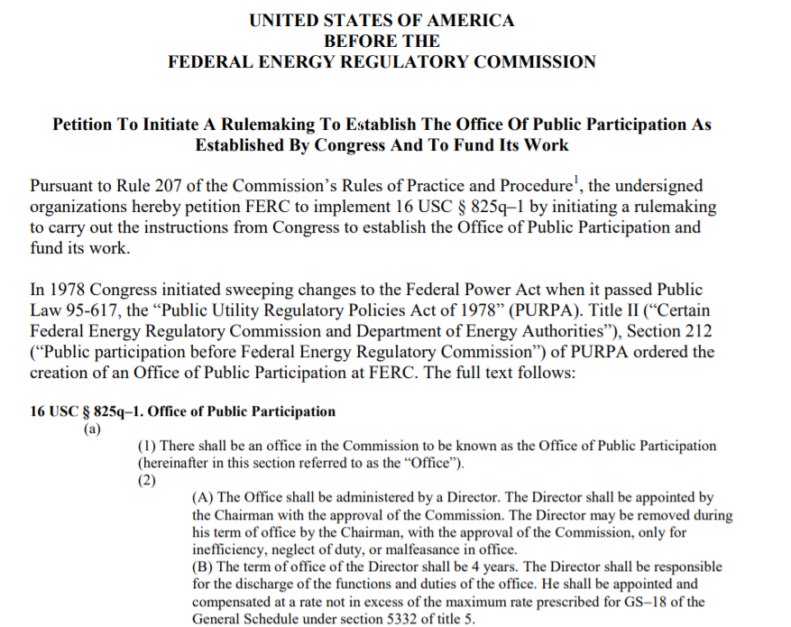
Public Citizen Led A 2016 Petition Asking FERC to Create & Fund the Office of Public Participation, But We’ve Been Ignored Thus Far
We have drafted a Petition for a Writ of Mandamus To FERC to compel the Commission to respond to our petition.
We prefer the existing statutory model that “coordinates assistance” rather than a consumer/public advocate.
The advocacy office could undermine public interest/environmental FERC advocacy if the advocacy office takes a contrary position from outside advocates like us.

Slide 10
Reform Option #2: Replace Some RTO Stakeholder Functions With FERC Advisory Committees
FERC is the only major federal agency that doesn’t utilize advisory committees
The 1972 Federal Advisory Committee Act ensures transparency of deliberations with standards exceeding those of all RTOs, including special emphasis on open meetings, public involvement, and reporting by members.
Advisory committees are deliberative functions that occur under the umbrella of federal laws and requirements, but where agendas and discussions can be led by non-FERC members.
FERC could have, for example, a “Carbon Pricing in NYISO” advisory committee, a “PJM Capacity Market” advisory committee, etc.
My experience as an advisory committee member with the U.S. CFTC is that it is a far superior venue and format that what RTOs provide.

Slide 11
Reform Option #3: Urge FERC To Conduct a Notice of Inquiry of Order 719
FERC hasn’t examined RTO governance and responsiveness to customers since the 2008 Order.
The intent of Order 719 was “to improve the operation of organized wholesale electric markets in the areas of . . . the responsiveness of RTOs to their customers and other stakeholders, and ultimately to the consumers who benefit from and pay for electricity services.”
Public Citizen believes governance, transparency and public access standards should be uniform across all RTOs.
A Notice of Inquiry is an opportunity to revisit RTO governance and public participation requirements.

Slide 12
“the Commission will require that RTOs and ISOs continue over time to consider customer and other stakeholder needs as the architecture or market environment of the RTO or ISO changes. This criterion is necessary to ensure that responsiveness continues into the future.” Order 719, At 509. "we find that RTOs and ISOs must provide an avenue for customers and other stakeholders to present their views on RTO and ISO decision-making, and to have those views considered.” Order 719, At 503.

Slide 13
Reform Option #4: Subject All RTOs to Federal Open Meeting Requirements and FOIA
Subject RTOs to federal open meeting and Freedom of Information laws.
Record and transcribe meetings to preserve archival records of proceedings.
Provide intervenor compensation to assist with public interest participation, either through FERC office or through the tariff (such as with CAPS in PJM).
Allow the general public and credentialed journalists free access to all stakeholder meetings.
Adjust weighted sector voting ratios to more realistically reflect true stakeholder involvement in energy markets.
RTO Board of Directors should be directly accountable to the public interest within the RTO geographic footprint. In the midst of the west coast deregulation crisis, the California assembly in January 2001 passed a law giving the Governor the power to appoint all CAISO board members.

Slide 14
Reform Option #5: Separate stakeholder function completely from the RTO (similar to NEPOOL, but have more structural accountability), or abandon the stakeholder process entirely (CAISO)
The RTOs were never really designed to be neutral arbiters of a mini-electricity democracy—there are too many conflicts of interest with RTO management.
NEPOOL has been a disaster because states and the public interest have no effective oversight. One could structure a stakeholder process as a separate not-for-profit with a steering committee and/or board that is directly accountable to interests within the RTO footprint.
Pursuing a CAISO model of no active stakeholder sector voting essentially requires the board of directors to perform that function—meaning the board must be accountable to and representative of the public interest.

