Slide 1

Slides prepared by Drs. Steffie Woolhandler & David Himmelstein, Faculty at the City University of New York at Hunter College and Harvard Medical School, and Research Associates, Public Citizen Health Research Group

Slide 2
Why was the U.S. so Vulnerable to COVID-19?
Deteriorating health status.
Weakened public health capacity.
Increasing economic inequality.
Racism that harms people of color and erodes support for safety-net programs.
Wasteful health care system that prioritizes profitability over needs.

Slide 3
Life expectancy in the US and other G7 countries, 1960–2018
Source: J. Bor based on OECD 2020

Slide 4
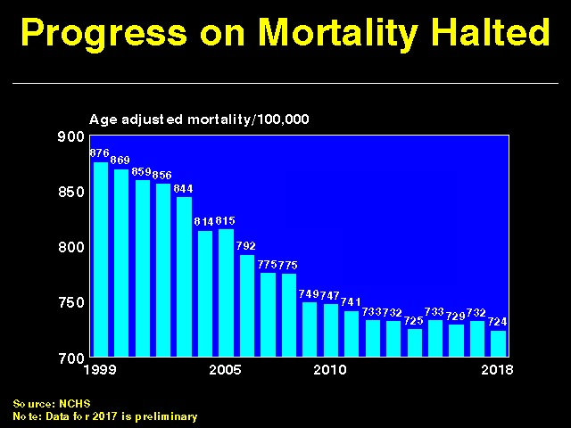

Slide 5
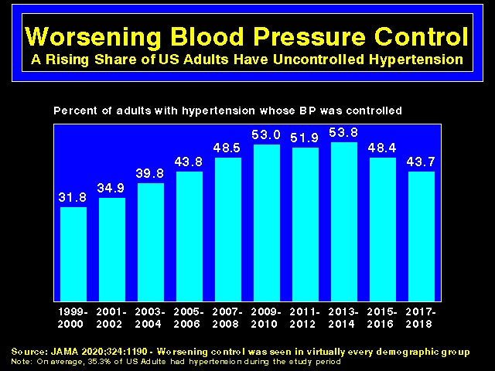

Slide 6
Weakened Public Health Capacity

Slide 7
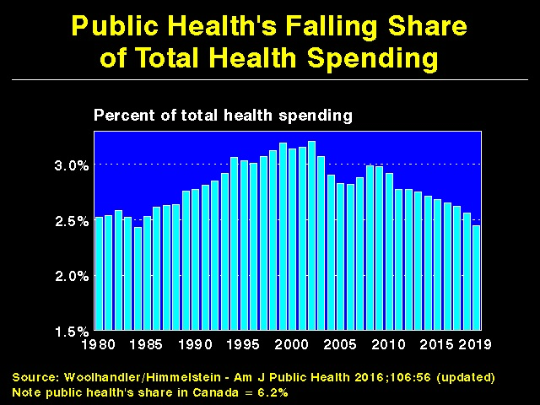

Slide 8
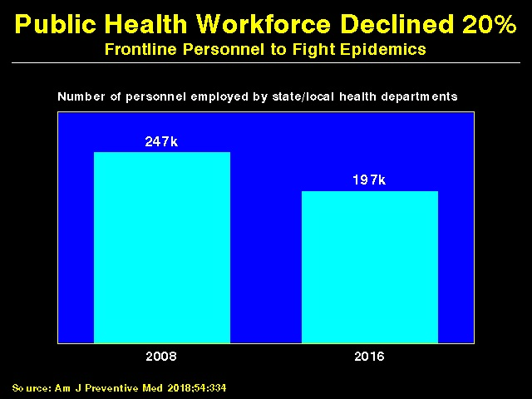

Slide 9
Trump Further Weakened Pandemic Response Capacity
2017 Hiring freeze at CDC left 700 vacant positions.
2018 - Abolished Global Health Security team of the National Security Council
1600 government scientists have left positions since January 2017.
Many key science policy positions (e.g. OSHA Administrator) remain vacant.
Defunding WHO in 2020 – A crime against humanity.

Slide 10
Increasing Economic Inequality

Slide 11
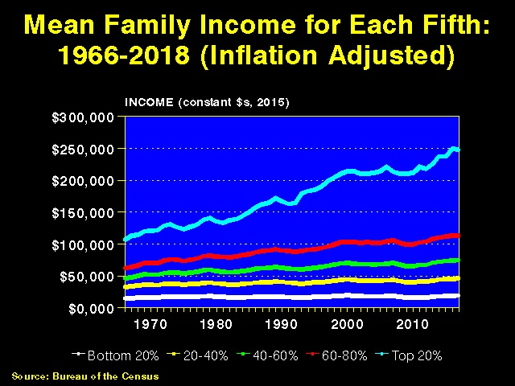

Slide 12
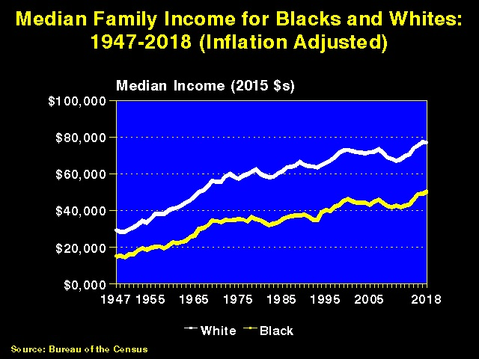

Slide 13
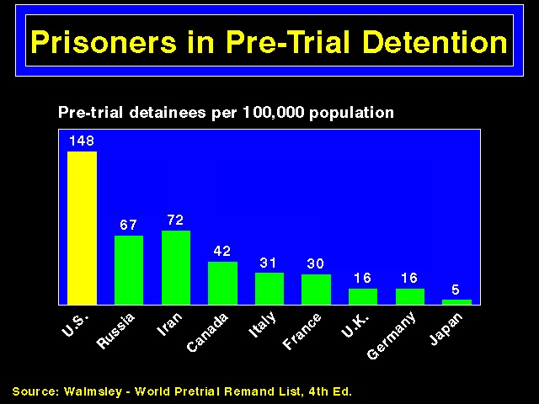

Slide 14
Increasing Economic Inequality Harms Health

Slide 15
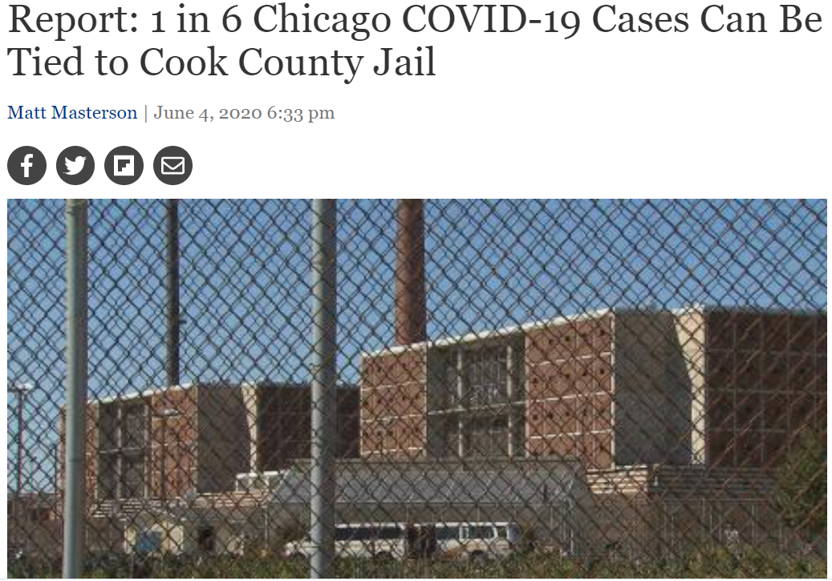
“The data suggest that cycling people through Cook County Jail alone is associated with 15.7 percent of all documented COVID-19 cases in Illinois.” (Health Affairs 6/4/20)

Slide 16
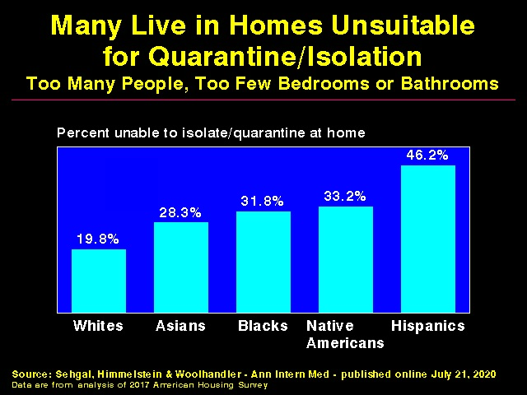

Slide 17
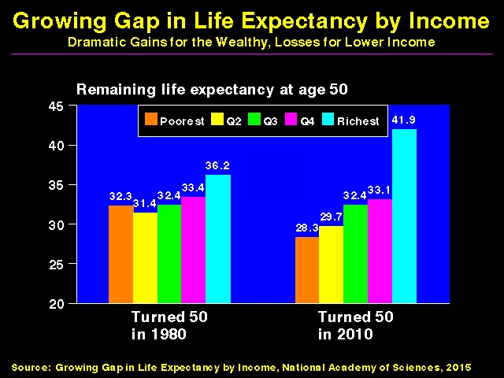

Slide 18
The Uninsured

Slide 19
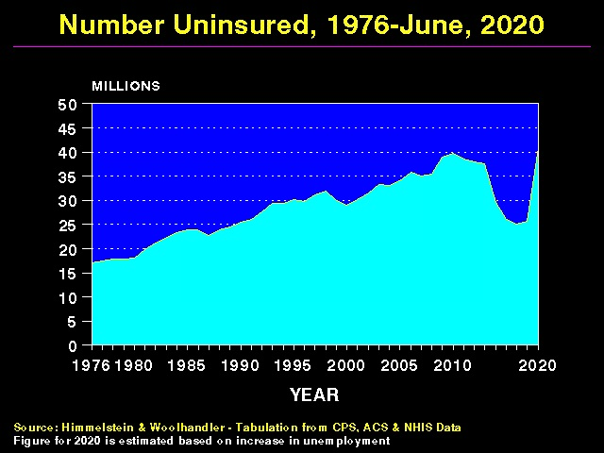

Slide 20
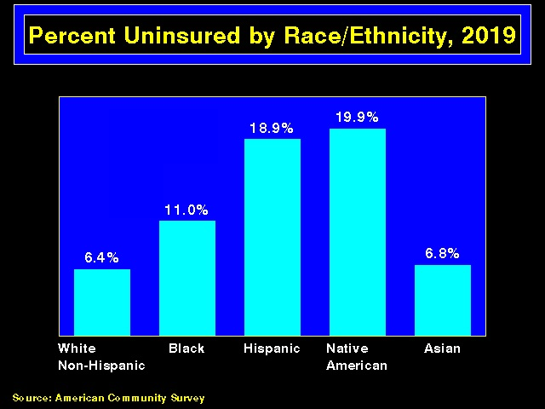

Slide 21
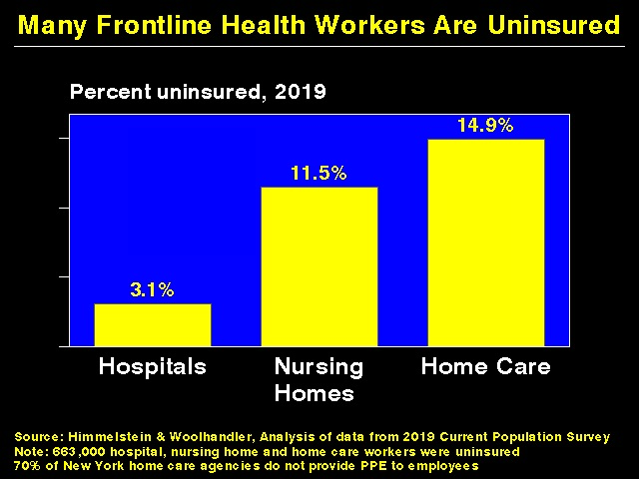

Slide 22
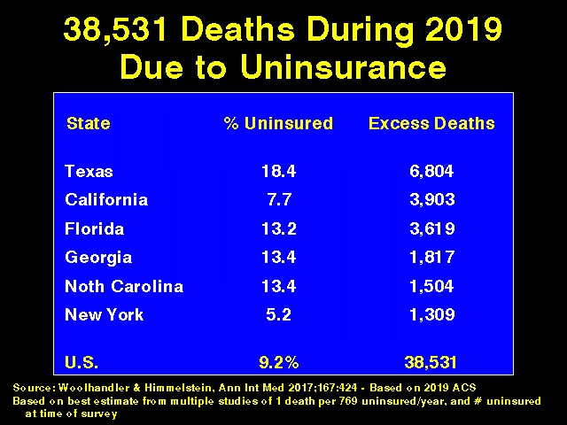

Slide 23
Medicaid:
Poor Access, But Better Than Nothing

Slide 24
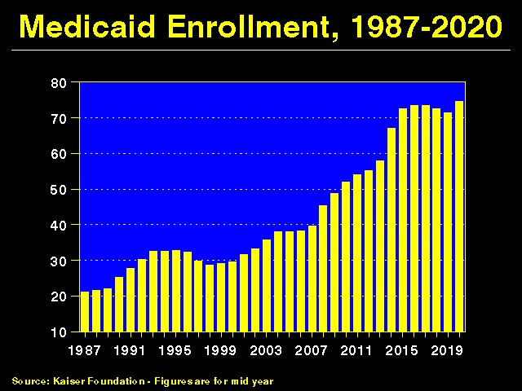

Slide 25
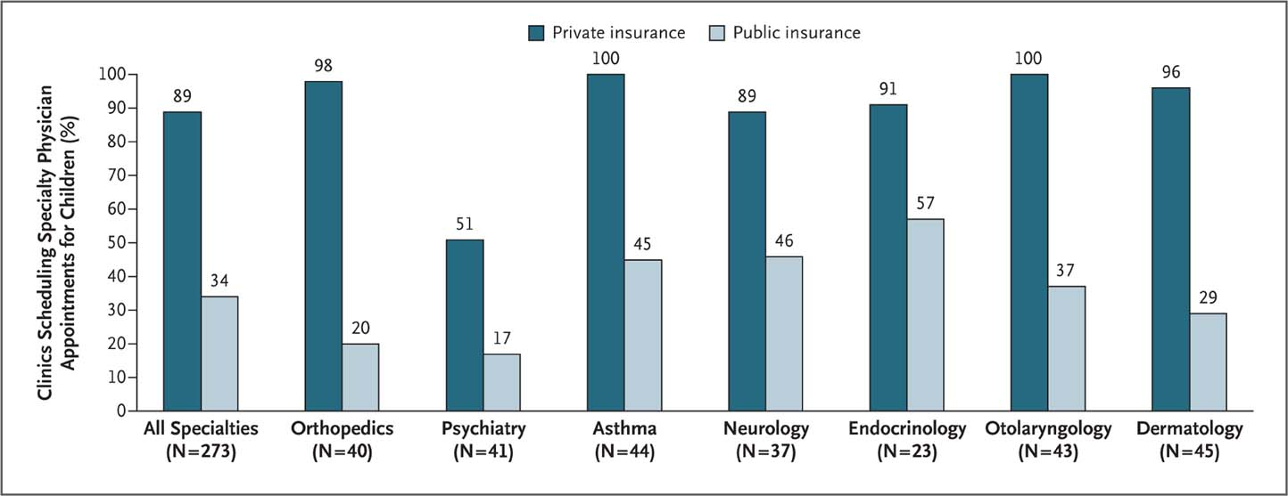
Many Specialists Won’t See Kids With Medicaid
Bisgaier J, Rhodes KV. N Engl J Med 2011;364:2324-2333
Notes:
Figure 2 Clinics Scheduling Specialty Care Appointments for Children, According to Type of Insurance. Public insurance was reported by callers as the Illinois Medicaid–Children's Health Insurance Program (CHIP) umbrella program; private insurance was reported by callers as Blue Cross Blue Shield. Each of the 273 clinics was called twice (for a total of 546 calls) by the same caller, with only insurance coverage varying between the two calls: once reporting Medicaid–CHIP coverage and once reporting private coverage. Calls were made 1 month apart, and the order of the reported insurance status was randomly assigned. Asthma clinics included 38 allergy–immunology clinics and 6 pulmonary disease clinics.

Slide 26
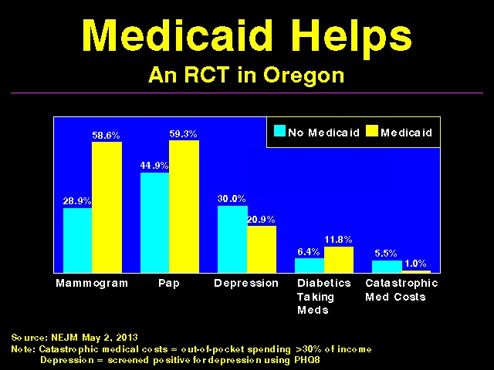

Slide 27
Under-Insurance
On the Rise

Slide 28
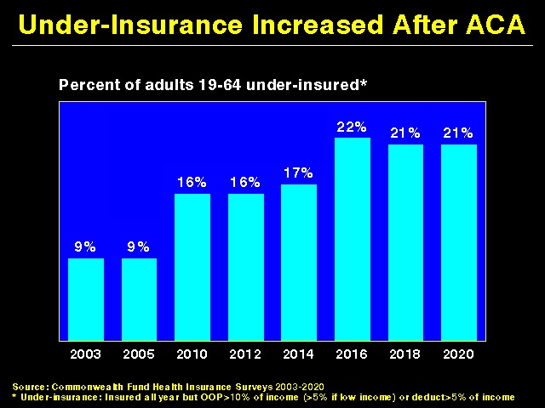

Slide 29
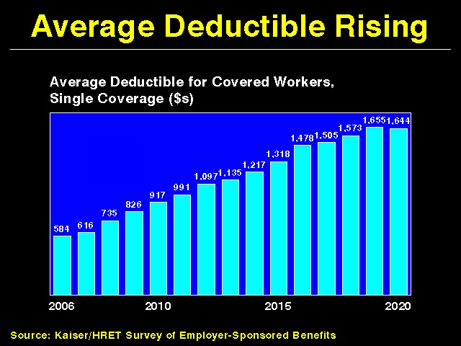

Slide 30
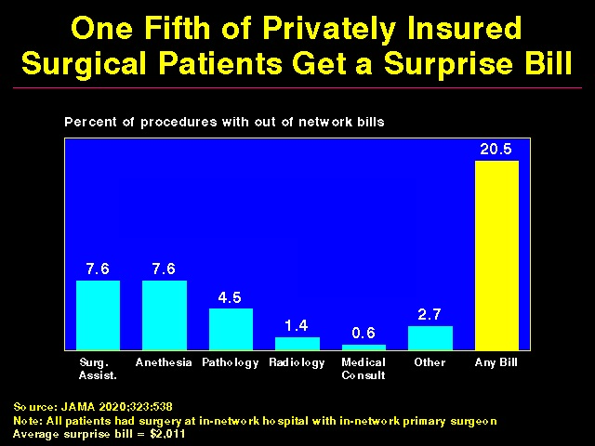

Slide 31
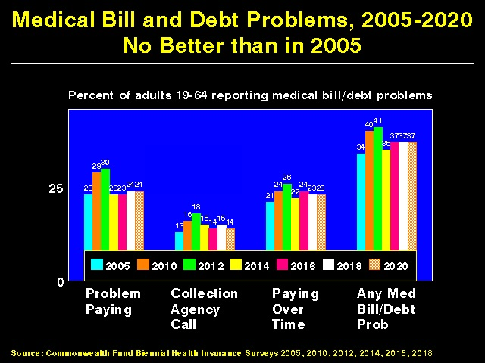

Slide 32
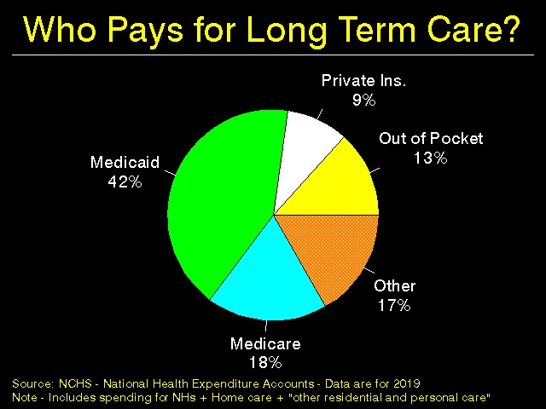

Slide 33
Under-Insurance
Impedes Care,
Worsens Health

Slide 34
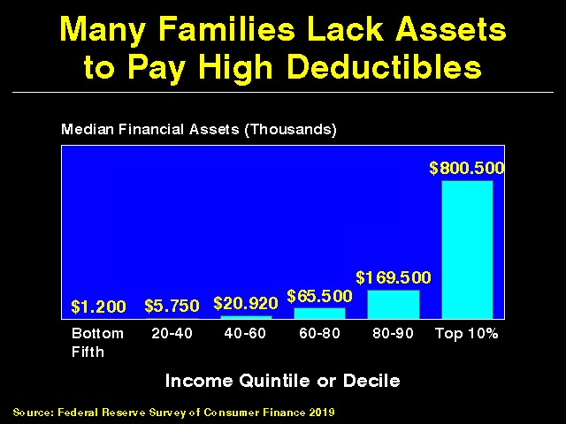

Slide 35
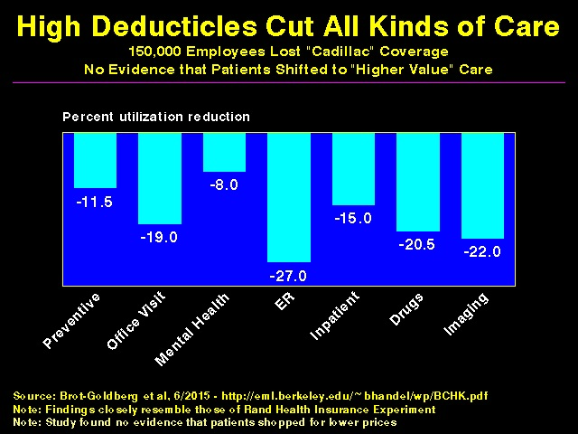

Slide 36
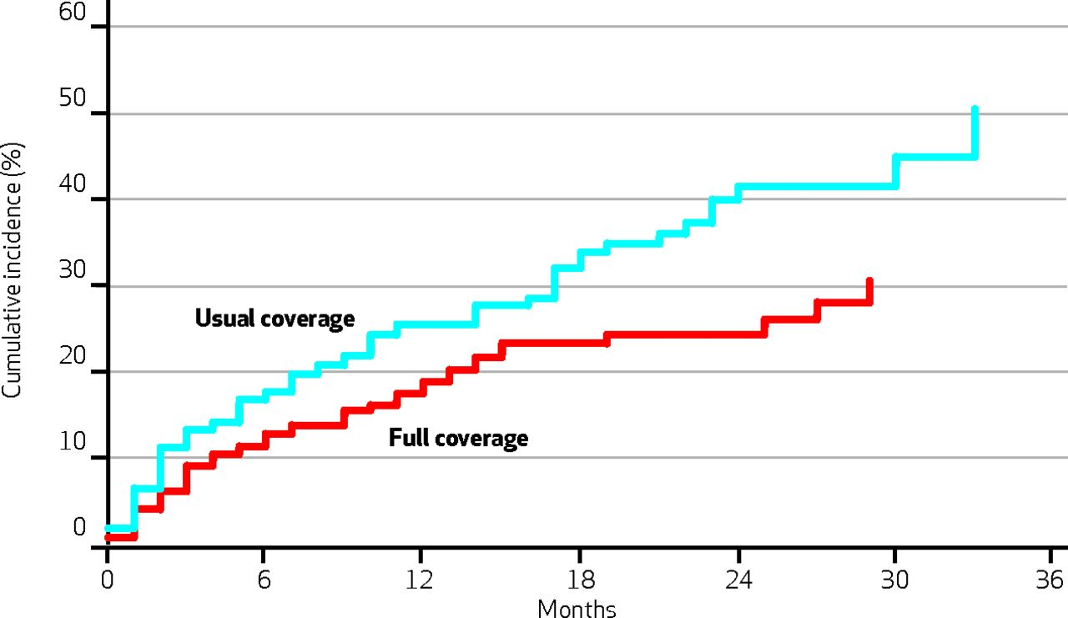
Medication Co-pays Increased Post-MI Vascular Events in Minorities – An RCT
Co-Pay Group
Free Med Group
Source: Health Aff 2014:33:863

Slide 37
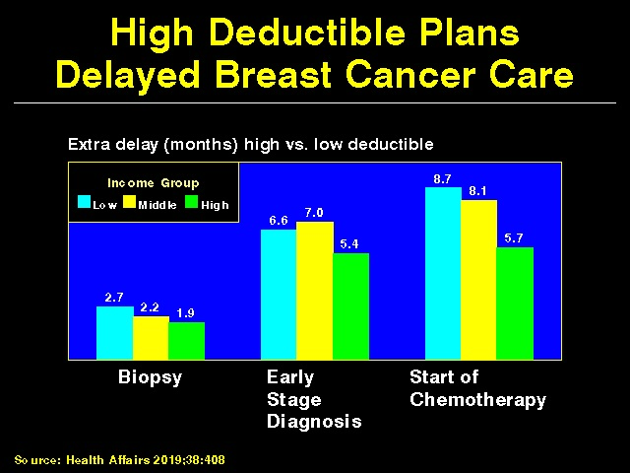

Slide 38
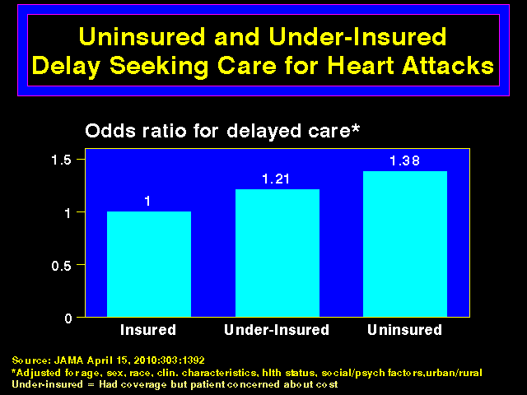

Slide 39
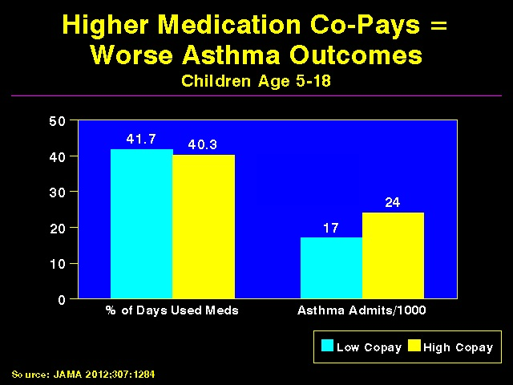

Slide 40
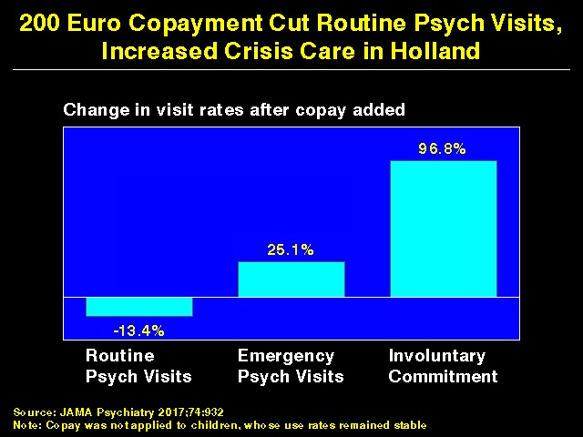

Slide 41
Under-Insurance:
A Leading Cause of Financial Distress and Ruin

Slide 42
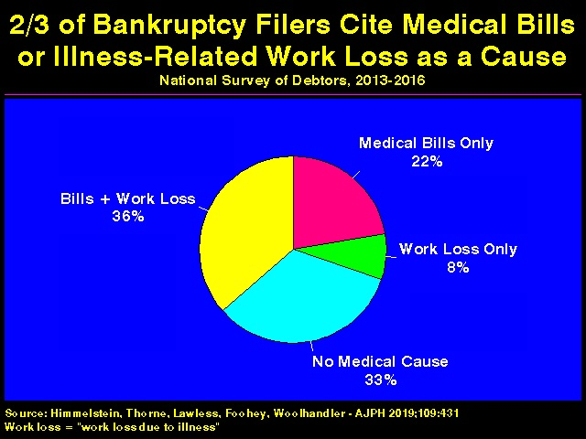

Slide 43
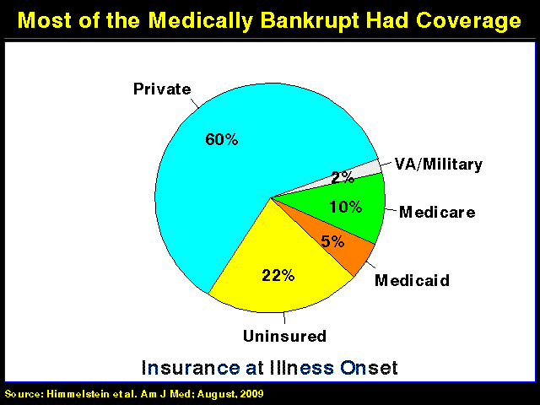

Slide 44
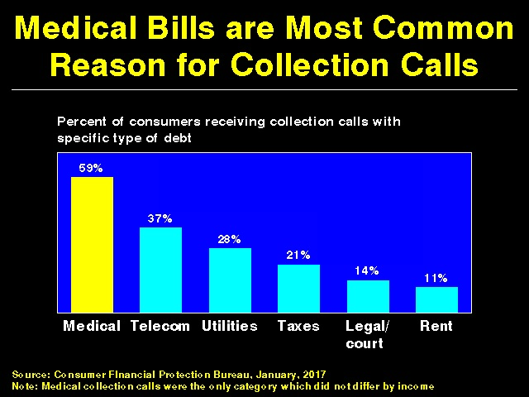

Slide 45
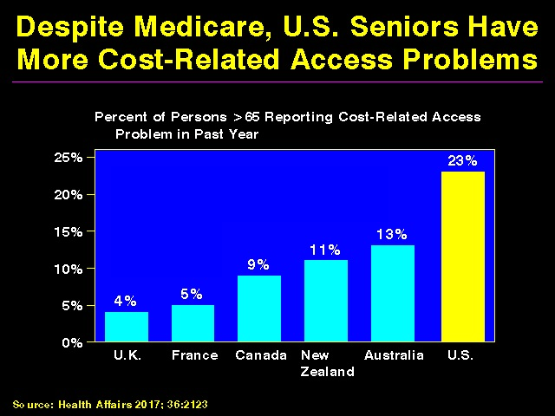

Slide 46
Racism Harms Health

Slide 47
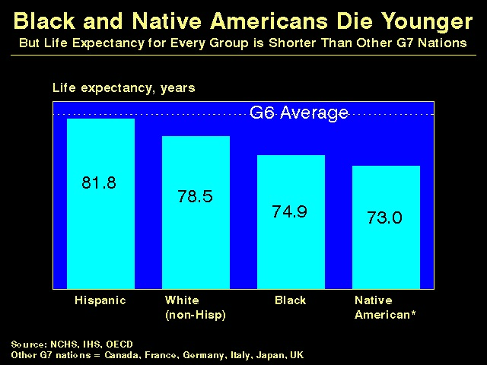

Slide 48
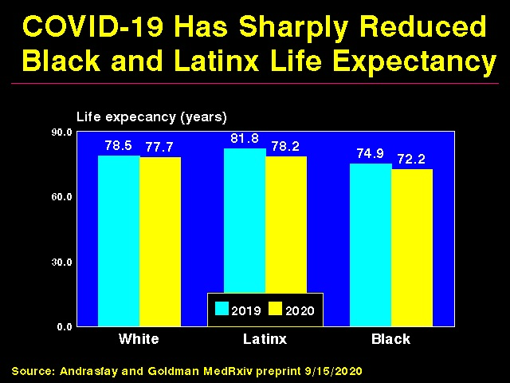

Slide 49
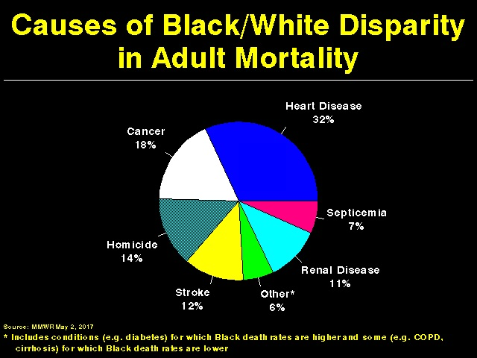

Slide 50
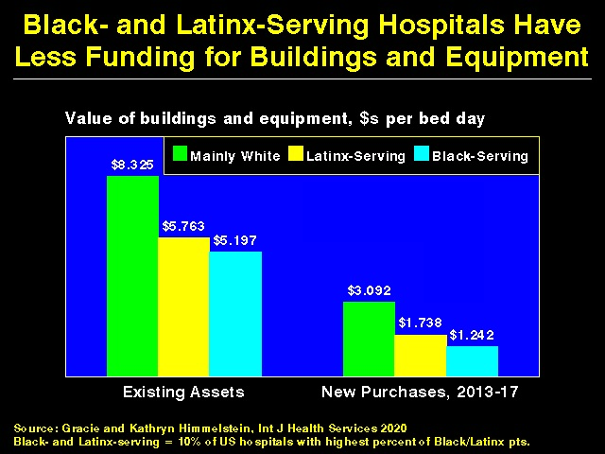

Slide 51
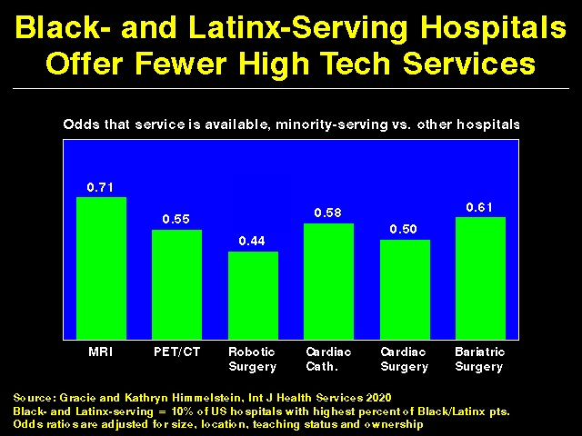

Slide 52
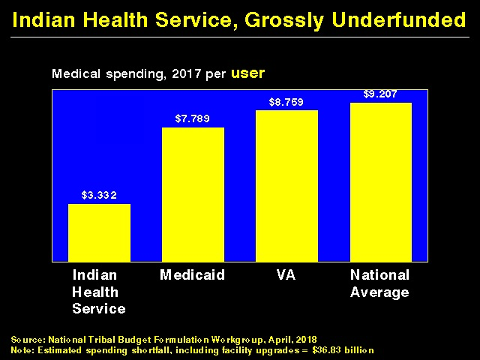

Slide 53
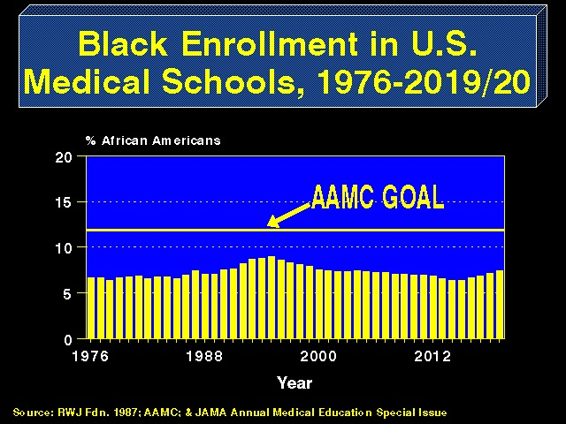

Slide 54
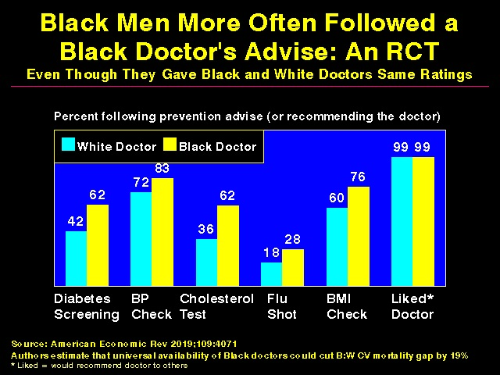

Slide 55
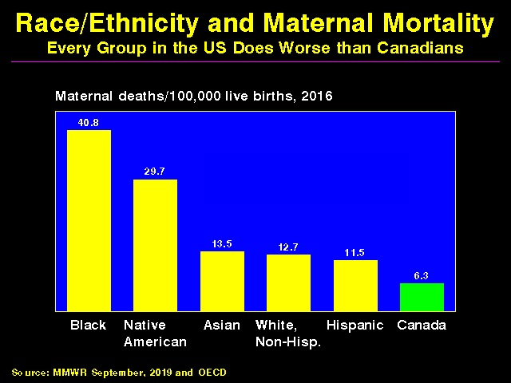

Slide 56
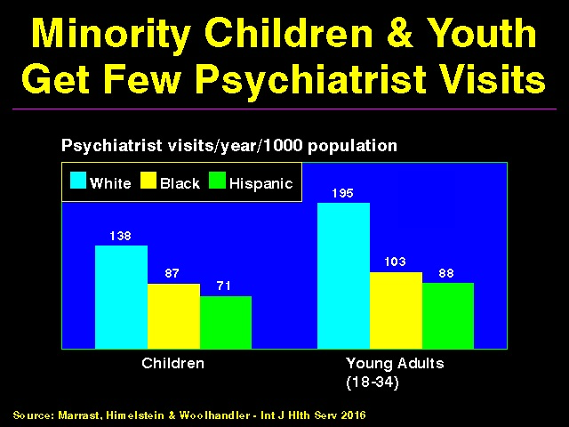

Slide 57
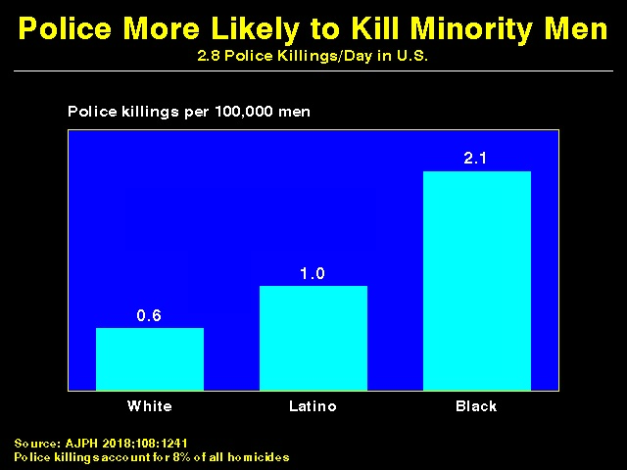

Slide 58
Protecting Immigrants’
Right to Health Care

Slide 59
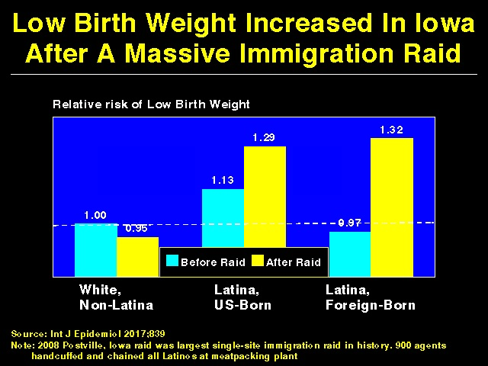

Slide 60
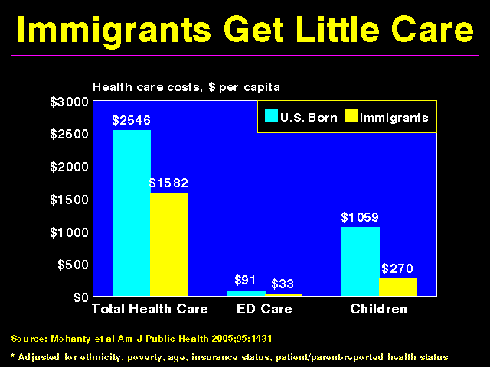

Slide 61
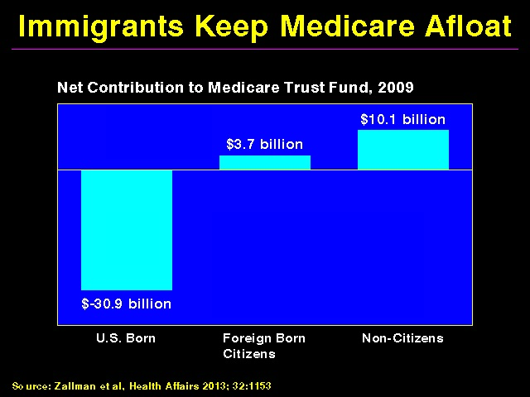

Slide 62
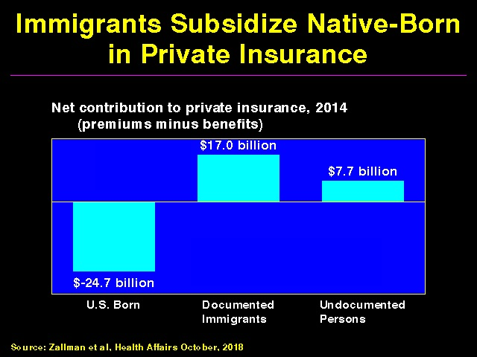

Slide 63
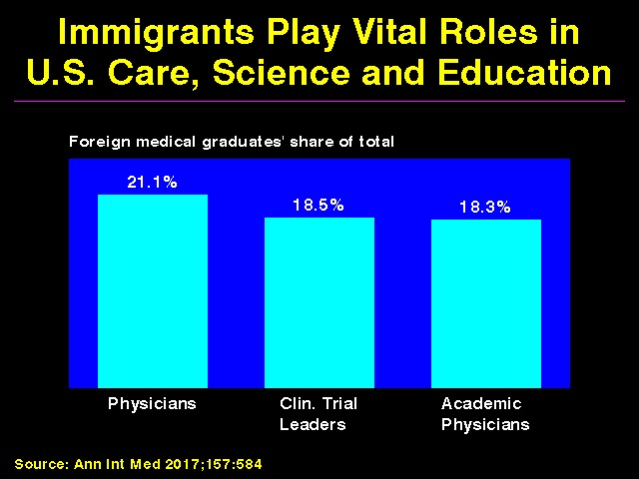

Slide 64
Administrative
Overhead Rising

Slide 65
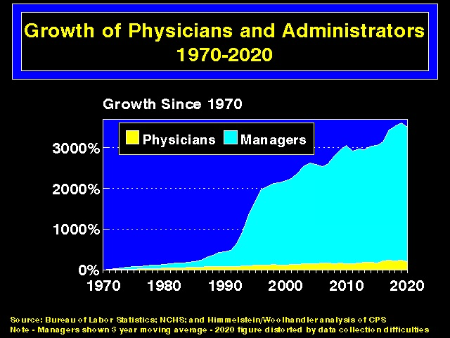

Slide 66


Slide 67
Investor-Owned Care:
Inflated Costs, Inferior Quality

Slide 68


Slide 69


Slide 70


Slide 71


Slide 72

For-Profit Hospitals Cost 19% More
Source: CMAJ 2004;170:1817
Notes:
72

Slide 73


Slide 74

For-Profit Dialysis Clinics’ Death Rates are 9% Higher
Source: JAMA 2002;288:2449
Notes:
74

Slide 75


Slide 76


Slide 77


Slide 78


Slide 79


Slide 80
Drug and Device Firms’ Inflated Prices

Slide 81


Slide 82


Slide 83


Slide 84
Drug Firms’ Strategy:
Pay the Ticket, Keep on Speeding
85% of drug firms paid fines for illegal activities, 2003-2016.
Most common violations: kickbacks, illegal marketing, overcharging.
Fines over 14 years = $33 billion (< ½ of single year profits).
21/26 firms engaged in illegal activities for at least 4 years.
Source: JAMA IM 2020;3324:1995

Slide 85


Slide 86
Private Insurers:
Middlemen Who Add
Costs But Not Value

Slide 87


Slide 88


Slide 89


Slide 90

Biden’s Health Reform Proposals
New “Medicare-like” Public Option.
Increase exchange subsidies to cap premiums at 8.5% of income.
Subsidy amount based on Gold plans.
Lower Medicare age to 60.
Free enrollment in public option for
persons <138% of FPL in non-
expansion state.

Slide 91
Medicare Advantage:
The Only Working Model of a Public Option (Traditional Medicare) Competing With Private Plans

Slide 92


Slide 93


Slide 94
How do Medicare Advantage Plans Outcompete Traditional Medicare?
Cherry-picking + Lemon-dropping
  Exclude hospitals/doctors attractive to high-cost patients
  Benefit/formulary design
  Hassle factor
Upcode + over-diagnose to game risk adjustment
Outright cheating

Slide 95

Medicare Advantage Plans’ Strategies:
1- Cherry Picking
Marketing, network manipulation, benefit design

Slide 96


Slide 97


Slide 98

Medicare Advantage Plans’ Strategies:
2 - Lemon Dropping
Network manipulation, benefit design, hassle factor

Slide 99


Slide 100


Slide 101


Slide 102


Slide 103

Medicare Advantage Plans’ Strategies:
3 - Cheating

Slide 104


Slide 105
Upcoding Boosts Advantage Plans’ CMS-Paid Premiums
Same Patient, Different Coding
Base rate $3950
Uncompl. DM $1040
CKD $0
Obesity $0
Depression $0
Chronic CAD $0
Total $4990
Base rate $3950
DM II with diab. CKD $3180
CKD stage 4 $2370
Morbid Obesity $2730
Major depression $3950
CAD with angina $1400
Total $17580
Source: SGIM Forum, 2017

Slide 106


Slide 107


Slide 108


Slide 109


ACOs
Warmed Over Managed Care

Slide 110


Slide 111


Slide 112


Slide 113


Slide 114
McKinsey:
“The Math of ACOs”
~$9 million/year/ACA spent on new data/analytics
~1.25% of total revenues for care management: Success depends on curtailing patients’ use of care and steering enrollees to lower-price providers, NOT managing chronic conditions.
Additional costs for “executive director, head of real estate, head of care management, and lawyers and actuaries”
Source: McKinsey & Co.. August 2020

Slide 115


Slide 116
The Toxicity of Pay for Performance (P4P)

Slide 117


Slide 118


Slide 119


Slide 120


Slide 121


Slide 122
Veterans Health Administration:
Better and Fairer Care

Slide 123


Slide 124


Slide 125
Mandate Model Reform:
Keeping Private Insurers
In Charge

Slide 126




“Mandate” Model for Reform
Expanded Medicaid-like program
  Free for poor
  Subsidies for low income
  Buy-in without subsidy for others
Employer Mandate +/- Individuals
Insurance Exchanges
Notes:
126

Slide 127


Slide 128

Medicare’s “Software”
18.9 Million Seniors Enrolled Within11 Months

Slide 129


Slide 131
American Taxpayers Already Pay More Than People in Nations With National Health Insurance

Slide 132


Slide 133


Slide 134
The U.S. Trails Other Nations on Health

Slide 135


Slide 136


Slide 137


Slide 138
High U.S. Costs Don’t
Result From Bad Health Habits, Aging or Overuse of Care

Slide 139


Slide 140


Slide 141


Slide 142


Slide 143


Slide 144


Slide 145


Slide 146
Canada’s Single Payer National Health Insurance Program

Slide 147


Slide 148


Slide 149


Slide 150


Slide 151


Slide 152


Slide 153


Slide 154
How Canada Controls Costs
Low administrative costs - 16.7% of health spending vs. 31.0% in U.S.
Lump-sum, global budgets for hospitals
Stringent controls on capital spending for new buildings and equipment
Single buyer purchasing reins in drug/device prices
Low litigation and malpractice costs
Emphasis on primary care
Exclusion of private insurers
Source: Himmelstein & Woolhandler, Arch Intern Med, December, 2012

Slide 155


Slide 156


Slide 157


Hospital Financing:
Medicare vs. Medicare
Per-patient payments
Capital and operating payments intermixed
New investments funded from surplus/profit
For-profits thrive
Global budget
Separate payment for capital
New investments funded by government grants
Eliminates opportunity for profitmaking

Slide 158


Slide 159


Slide 160


Slide 161


Slide 162


Slide 163


Slide 164
Medicare for All Enjoys Wide Support

Slide 165


Slide 166


Slide 167


Slide 168
A National Health Program for the U.S.

Slide 169


Slide 170


Slide 171


Slide 172
Global Operating Budgets:
Key to Single Payer Savings
Cuts hospital administrative costs.
Eliminates disparities in profitability of patients.
Banning hospitals from keeping surplus minimizes entrepreneurial incentives.
Funding capital through explicit grants minimizes unneeded duplication of expensive services.

Slide 173
Prescription Drugs and Single Payer
Full coverage, no deductibles/copays.
Prices reduced by negotiations, national formulary, threat of patent revocation.
Funding for public drug development, testing, and (when necessary) manufacture.
Raise standards and FDA funding for drug approval, marketing and post-approval surveillance.
Eliminate tax deductions for advertising; prohibit pharma-funded CME and guideline development.
Source: Gaffney, Lexchin, Angell, Carome et al. BMJ 2018;361:K1039

Slide 174


Current Senate and House Bills
Strengths
Universal coverage, single public plan
Comprehensive acute care benefits
No copays for covered services
Bans duplicative private coverage
Exemption from Hyde Amendment
Drug formulary and price negotiations

Slide 175
Current Senate and House Bills
Concerns
Both allow for-profit providers, with some constraints
Senate bill: Adopts Medicare’s needlessly complex payment strategies, raising administrative burdens/costs and perpetuating incentives for upcoding etc., focusing on profitable services, etc.

Slide 176
Single Payer Transition:
For Displaced Clerical and Administrative Workers
All 400,000 health insurance workers and about ½ of the 2.6 mil. clerical/administrative employees in healthcare providers likely to be displaced – total 1.7 million.
Many likely to be redeployed in expanded clinical workforce.
Funding for income support and job retraining modeled on WWII GI Bill.

Slide 177


Slide 178
Single Payer Transition:
For Patients
Every U.S. resident receives an insurance card.
Full coverage for all medically necessary care, no copayments, deductibles or coinsurance.
Prescription drug formulary, with alternatives covered when medically indicated
Free choice of any participating provider or hospital.

Slide 179
Medicare for All vs.
Medicare for More
(e.g. Public Option)

Slide 180
Single Payer and Private Coverage
Allowed: Supplemental non-competing –but can only cover benefits NOT covered by the public plan.
Banned:: Private insurance (including Medicare Advantage) duplicating public plan benefits – Key to administrative savings.

Slide 181
Public Option Rhetoric
“Don’t strip 150 million Americans of their private insurance; let them choose”
“M4A means a giant tax increase”
“If public is better, it will outcompete private insurance”
“There’s lots of ways to get to universal care”

Slide 182


Slide 183
Public Option = High Costs
Less savings than single payer on insurers’ overhead
Multiple payers = no savings on doctor/hospital billing and administration.
Private insurers will tilt the playing field (as under Medicare Advantage) raising system-wide costs and perpetuating network restrictions, cherry-picking, lemon dropping, upcoding, cheating.
Higher system-wide costs (compared to single payer) assure political pressure for benefit cuts.

Slide 184


Slide 185


Slide 186


Slide 187

“…There are no charges, except for a few special items”
“…no insurance qualifications”
An equal right to healthcare
Source: http://museum.hackney.gov.uk/object9232

