Slide 1

Slides prepared by Drs. Steffie Woolhandler & David Himmelstein, Faculty at the City University of New York at Hunter College and Harvard Medical School, and Research Associates, Public Citizen Health Research Group

Slide 2
Life expectancy in the US and other G7 countries, 1960–2018
Source: J. Bor based on OECD 2020

Slide 3
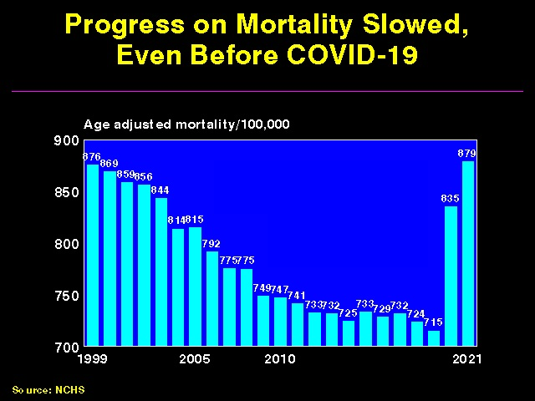

Slide 4
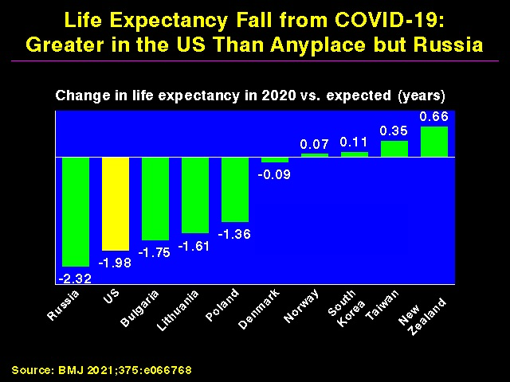

Slide 5
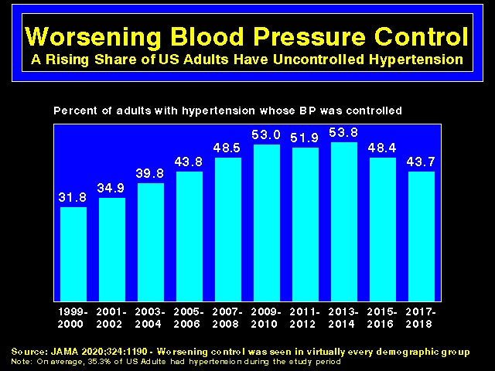

Slide 6
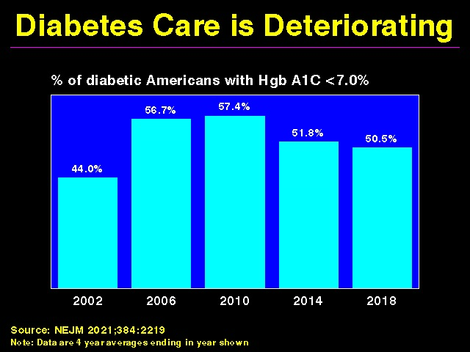

Slide 7
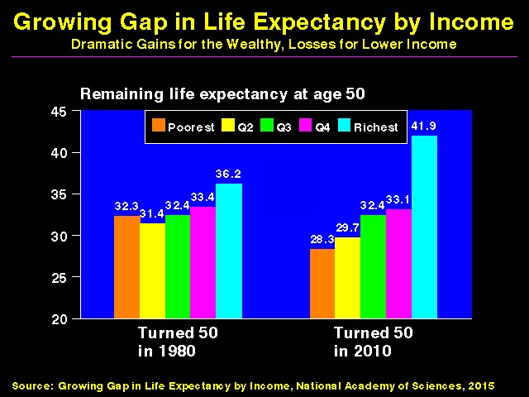

Slide 8
The Uninsured

Slide 9
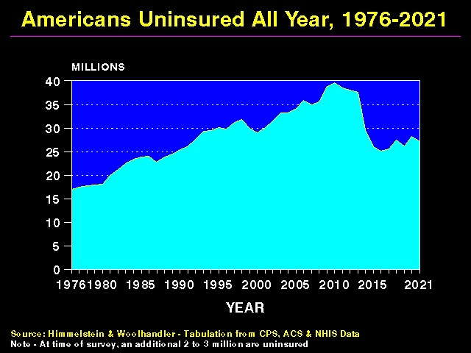

Slide 10
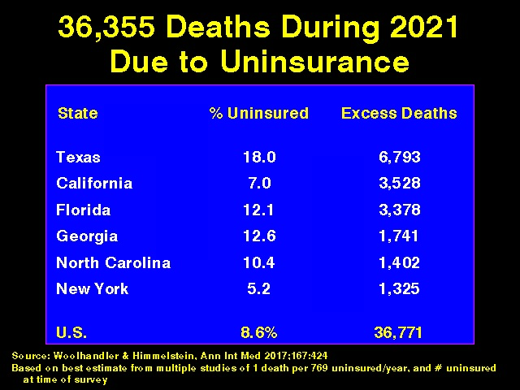

Slide 11
Medicaid:
Poor Access, But Better Than Nothing

Slide 12
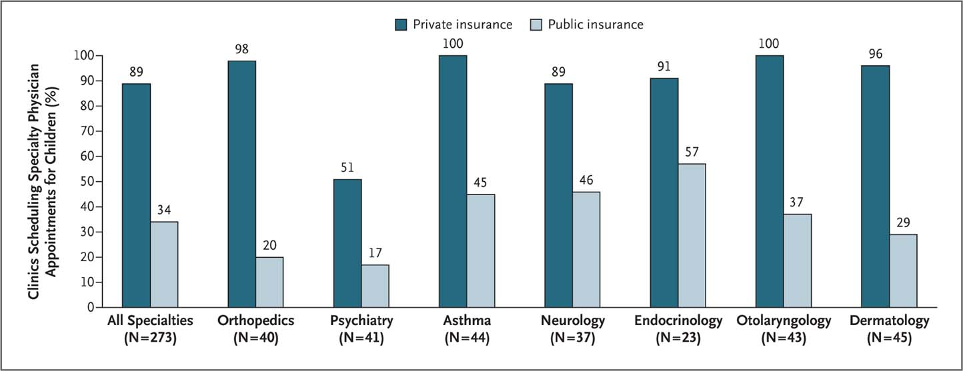
Many Specialists Won’t See Kids With Medicaid
Bisgaier J, Rhodes KV. N Engl J Med 2011;364:2324-2333
Notes:
Figure 2 Clinics Scheduling Specialty Care Appointments for Children, According to Type of Insurance. Public insurance was reported by callers as the Illinois Medicaid–Children's Health Insurance Program (CHIP) umbrella program; private insurance was reported by callers as Blue Cross Blue Shield. Each of the 273 clinics was called twice (for a total of 546 calls) by the same caller, with only insurance coverage varying between the two calls: once reporting Medicaid–CHIP coverage and once reporting private coverage. Calls were made 1 month apart, and the order of the reported insurance status was randomly assigned. Asthma clinics included 38 allergy–immunology clinics and 6 pulmonary disease clinics.

Slide 13
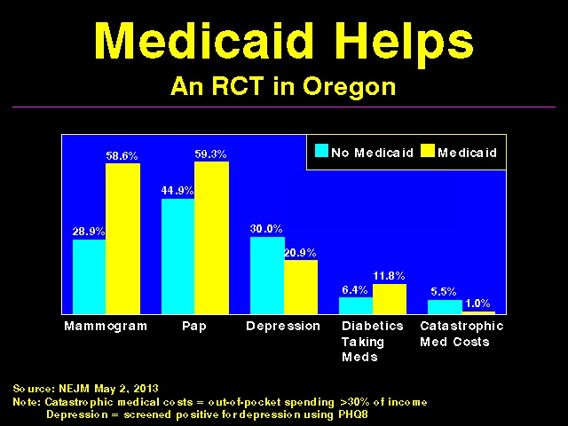

Slide 14
Under-Insurance

Slide 15
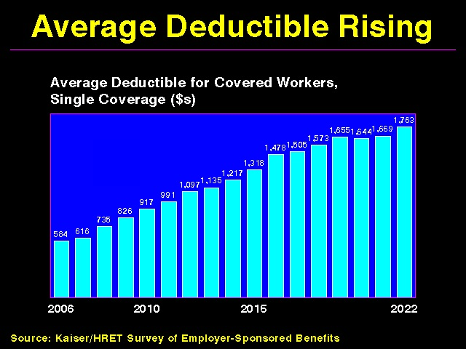

Slide 16
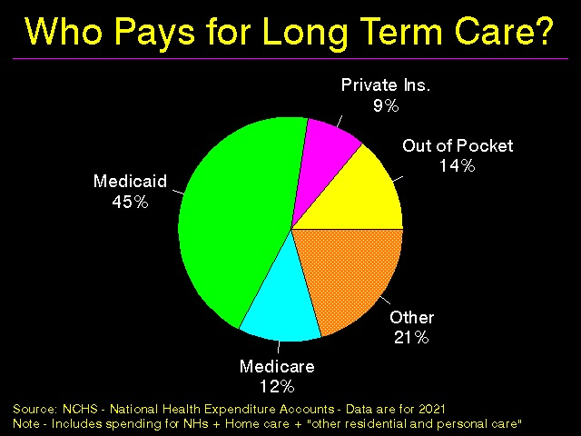

Slide 17
Under-Insurance
Impedes Care,
Worsens Health

Slide 18
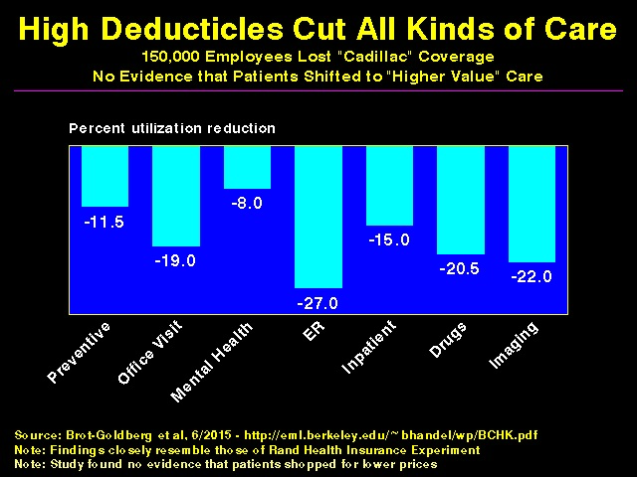

Slide 19
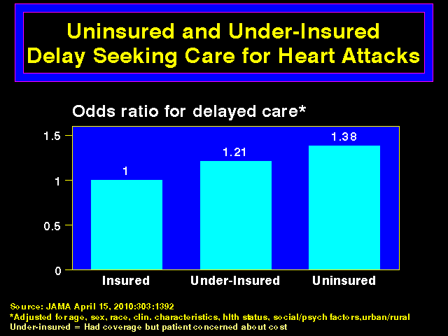

Slide 20
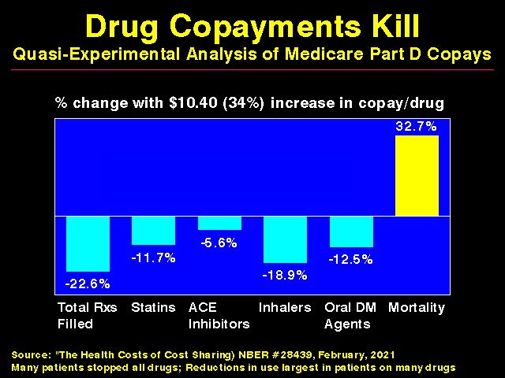

Slide 21
Under-Insurance:
A Leading Cause of Financial Distress and Ruin

Slide 22
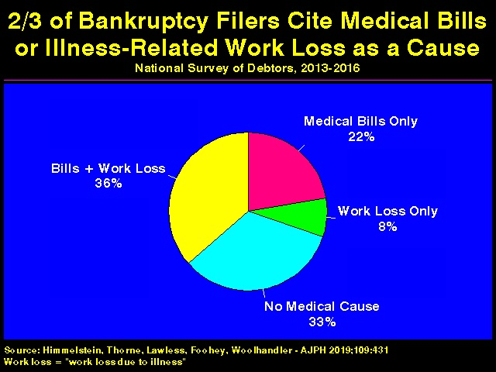

Slide 23
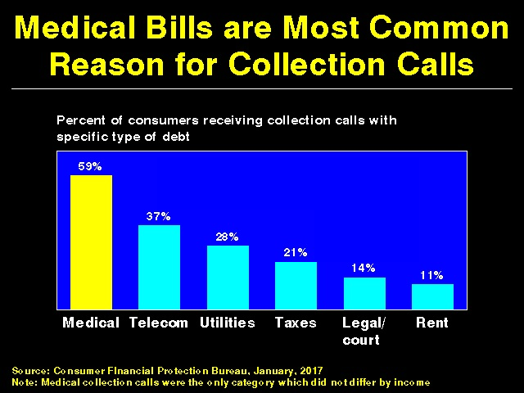

Slide 24
Racism Harms Health

Slide 25
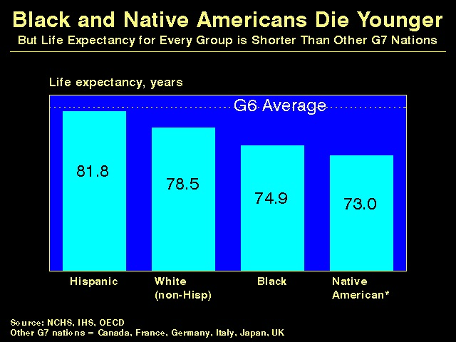

Slide 26
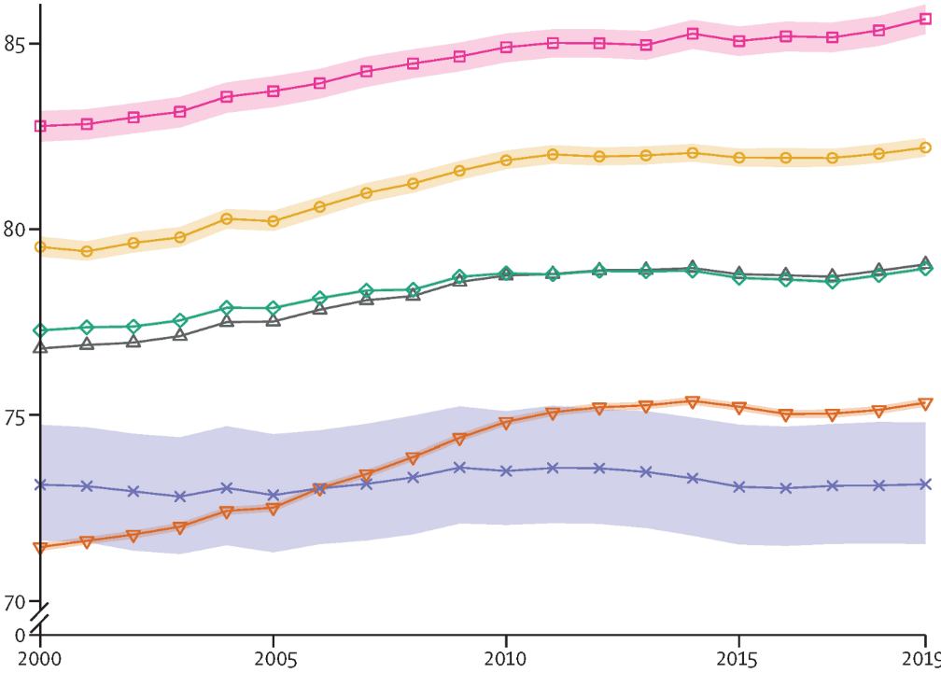
Native Americans Die Youngest
Asian
Life
Expectancy
Hispanic
White
US Total
Black
American Indian/Alaska Native
Source: Lancet 2022;400:25

Slide 27
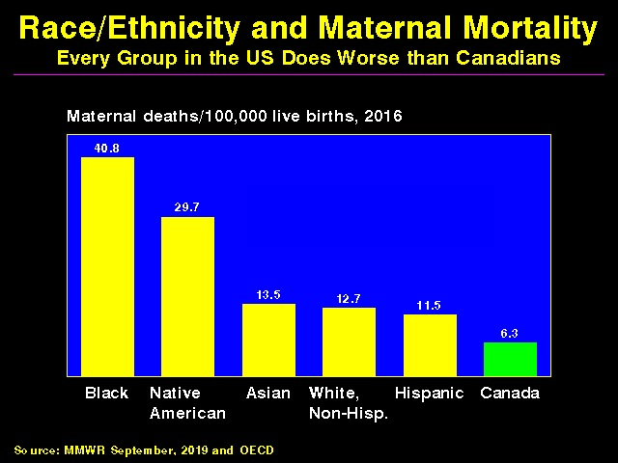

Slide 28
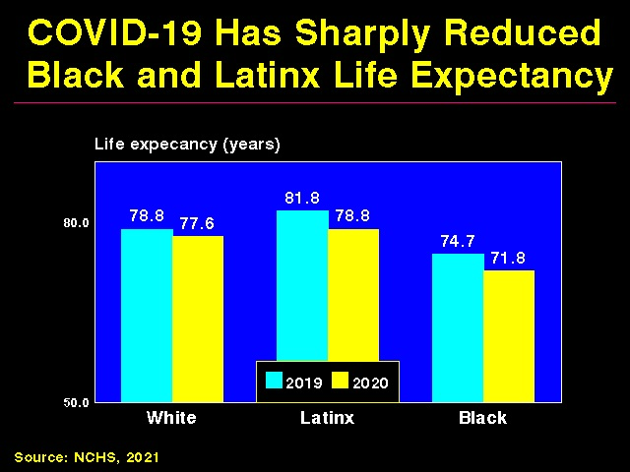

Slide 29
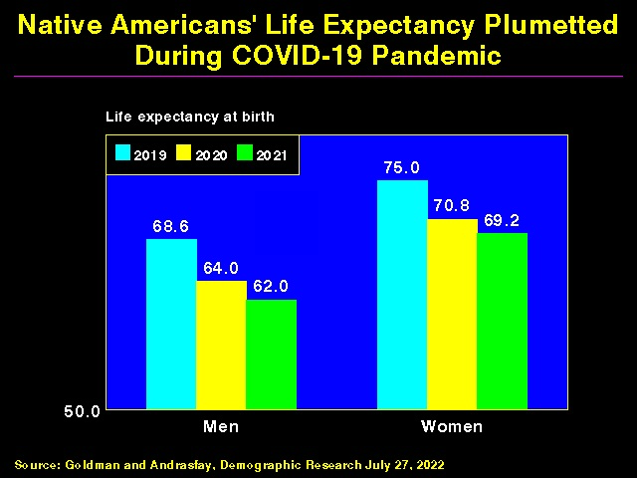

Slide 30
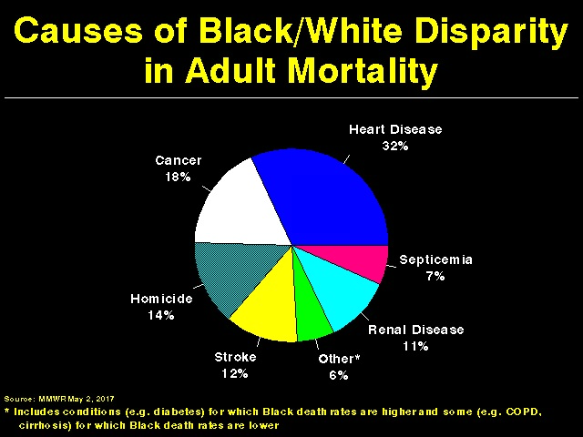

Slide 31
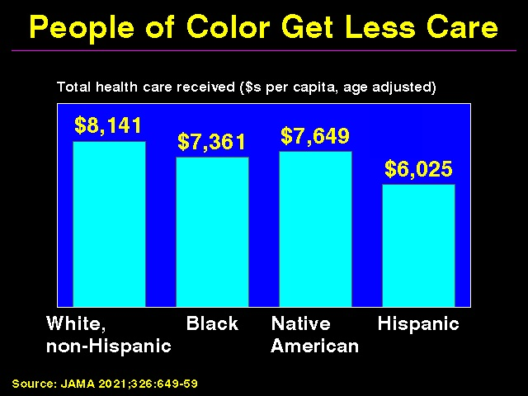

Slide 32
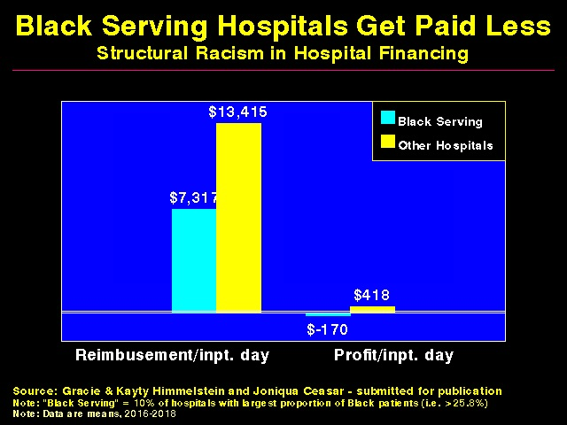

Slide 33
Protecting Immigrants’
Right to Health Care

Slide 34
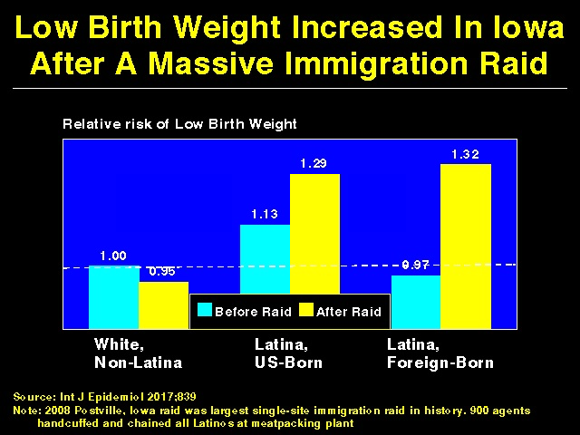

Slide 35
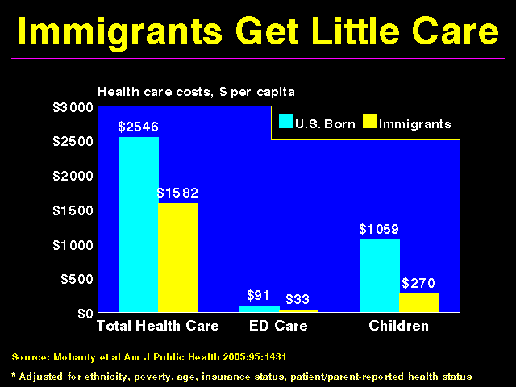

Slide 36
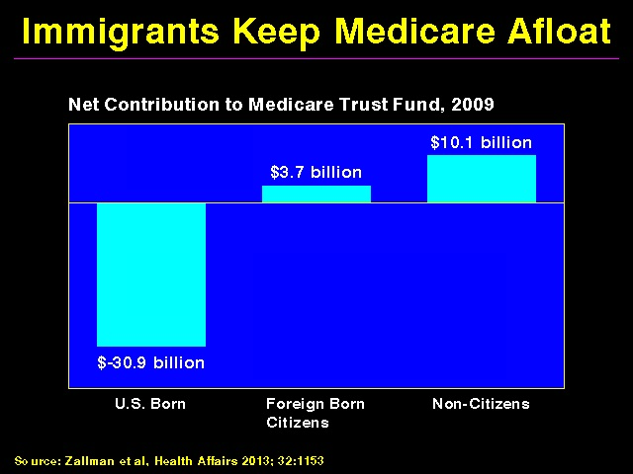

Slide 37
Administrative
Overhead Rising

Slide 38
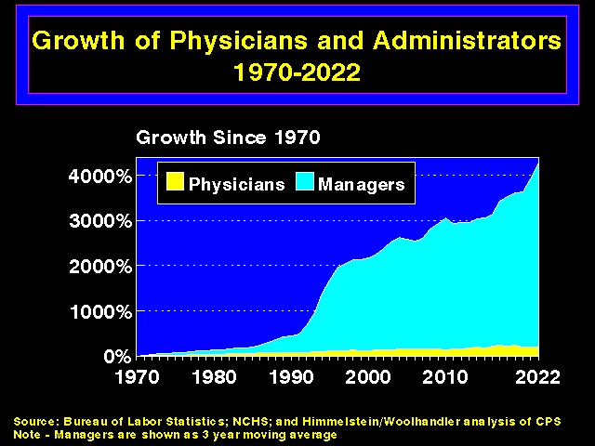

Slide 39
Investor-Owned Care:
Inflated Costs, Inferior Quality

Slide 40
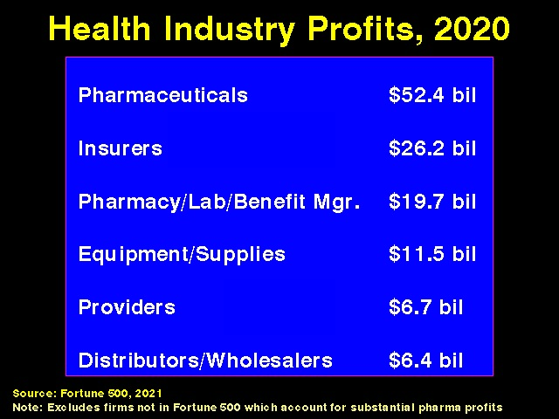

Slide 41
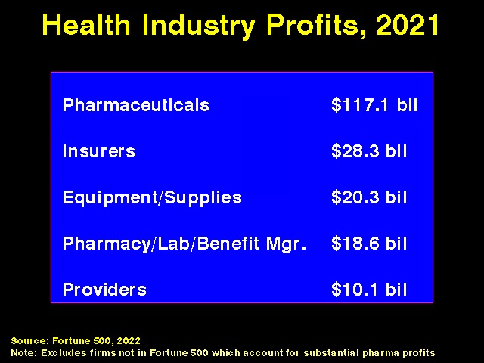

Slide 42
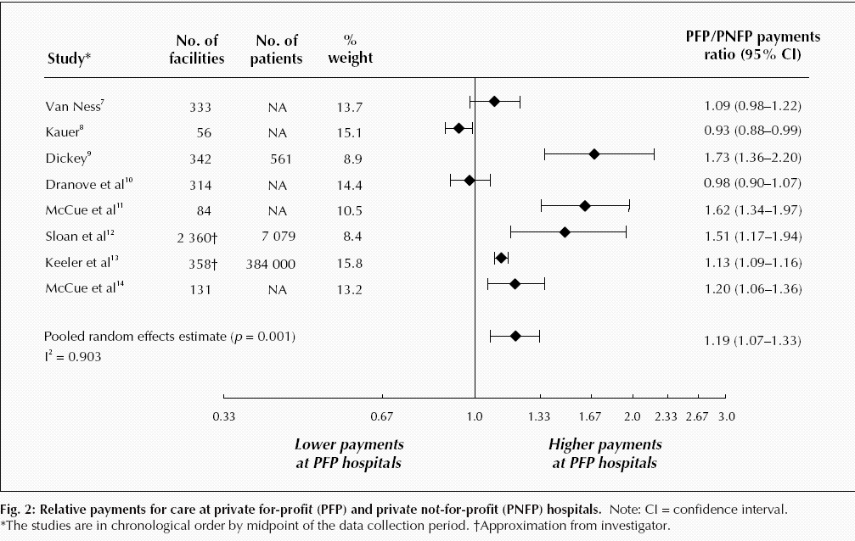
For-Profit Hospitals Cost 19% More
Source: CMAJ 2004;170:1817
Notes:
42

Slide 43
FFor-Profit Dialysis Clinics’ Death Rates are 7% Higher
3800 Excess Death Annually
Source: Dickman, Mirza et al. Int J Health Serv 2021;51:371

Slide 44
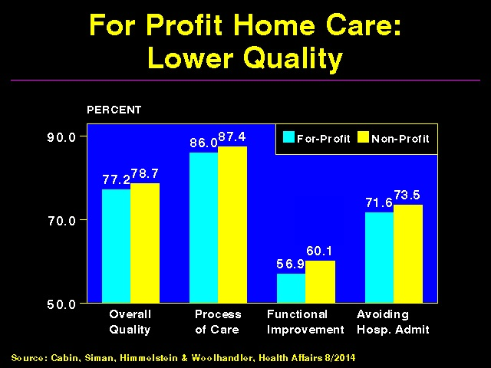

Slide 45
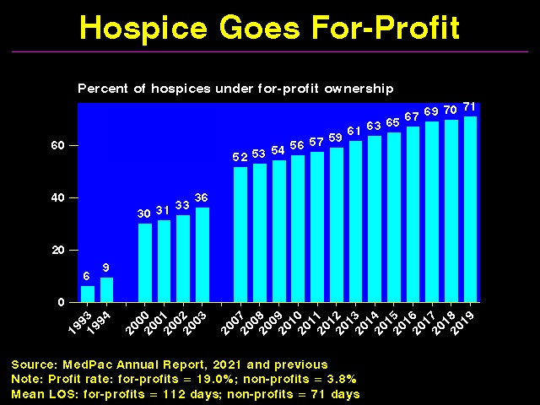

Slide 46
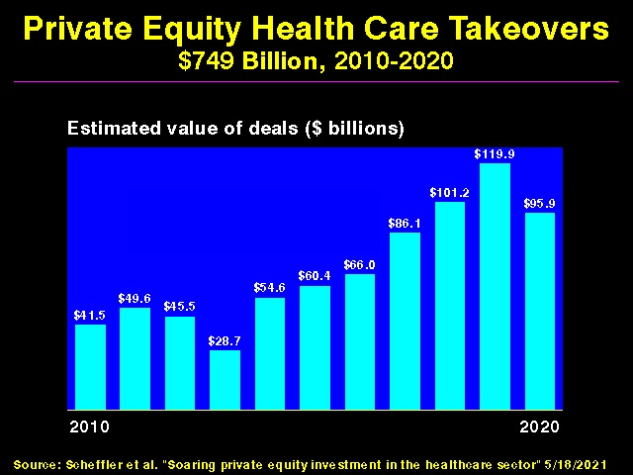

Slide 47
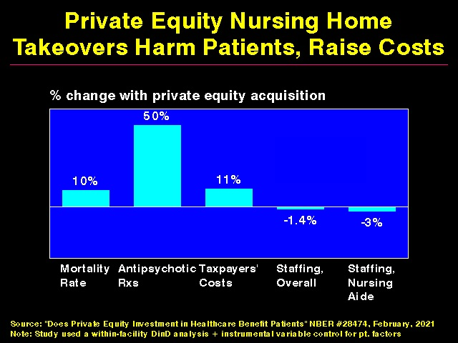

Slide 48
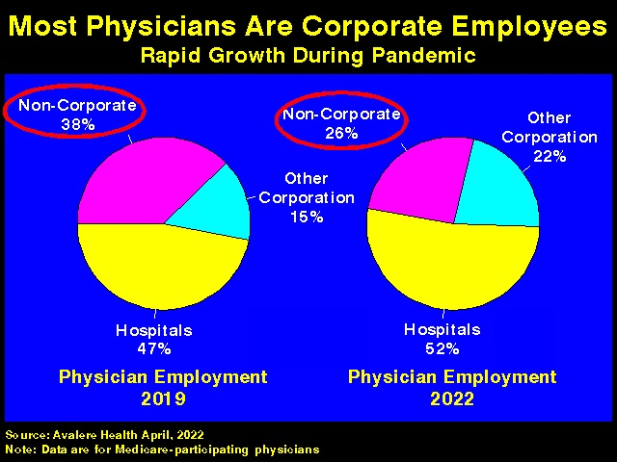

Slide 49
What Happens When PE Buys a Dermatology Practice?
Push sales of cosmeceuticals.
Offer bonuses for increasing elective procedures (and continued elective procedures throughout pandemic).
Pushed MDs to increase (e.g. double) visit #s.
Mobile clinicians do frequent skin check and biopsies on demented nursing homes patients.
Bring dermatopathology services “in house”, increasing biopsy rates and likely false positive melanoma Dxs.
Extensive use of poorly-supervised PAs and NPs for skin checks and procedures.
Skimp on supplies.
Increase Medicare billings/taxpayer costs.
Sources: Bloomberg Law 5/20/2020; NBC News 12/20/2021; NY Times 10/26/2018 & 11/20/2017

Slide 50
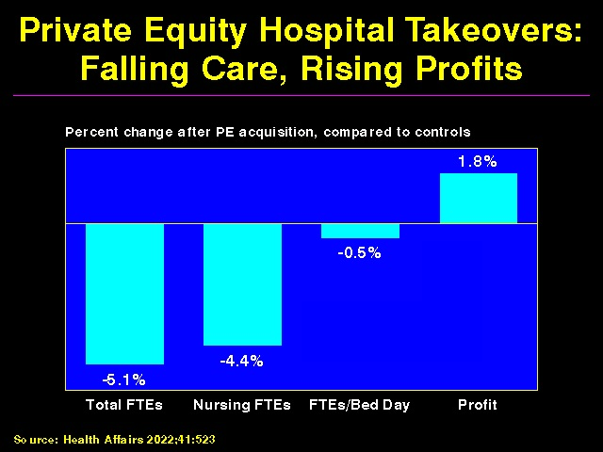

Slide 51
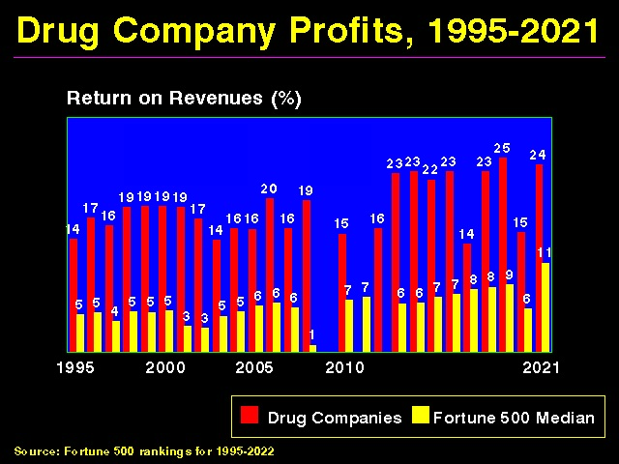

Slide 52
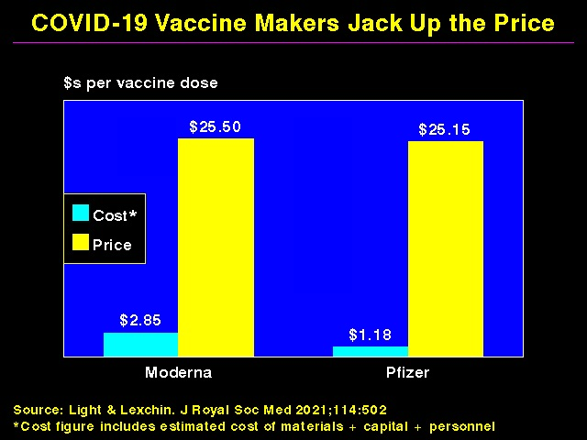

Slide 53
Private Insurers:
Middlemen Who Add
Costs But Not Value

Slide 54
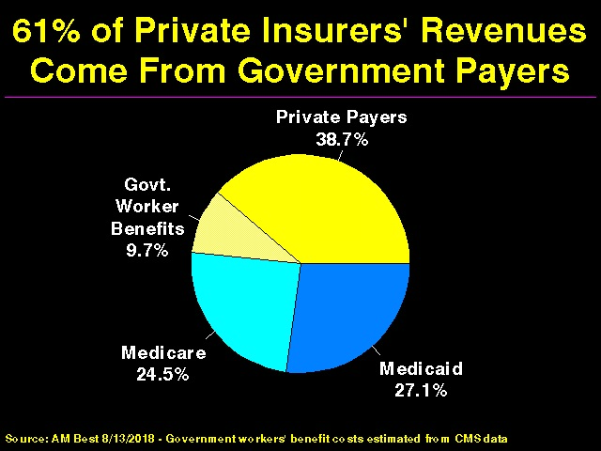

Slide 55
Medicare Advantage:
Privatizing Medicare, Raising Taxpayers’ Costs and a Public Option Preview

Slide 56
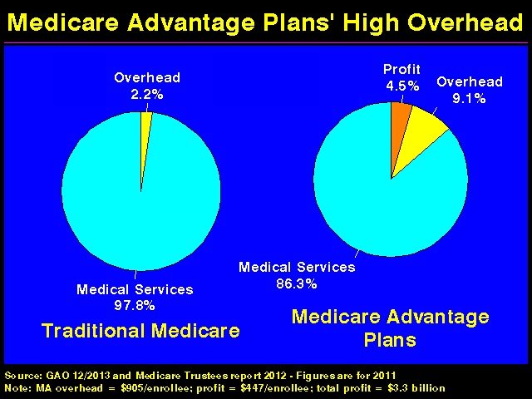

Slide 57
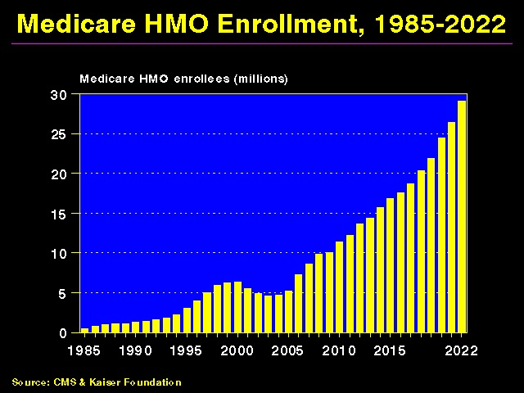

Slide 58
How do Medicare Advantage Plans With High Overhead Outcompete Traditional Medicare?
Cherry-picking + Lemon-dropping
  Exclude hospitals/doctors attractive to high-cost patients
  Benefit/formulary design
  Hassle factor
Upcode + over-diagnose to game risk adjustment
Outright cheating

Slide 59
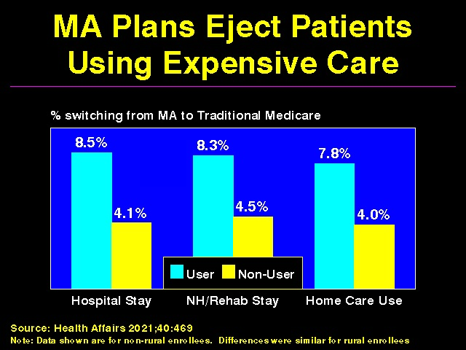

Slide 60
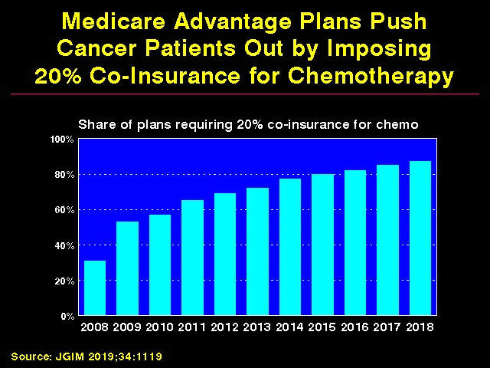

Slide 61
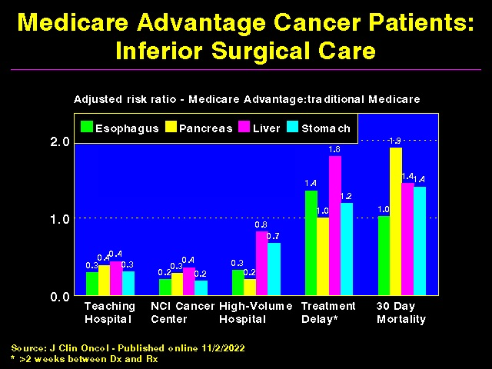

Slide 62
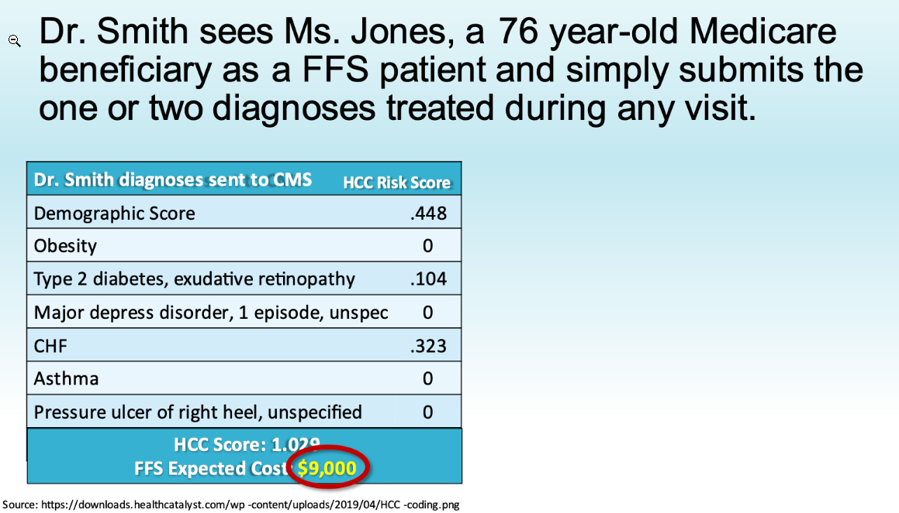

Slide 63
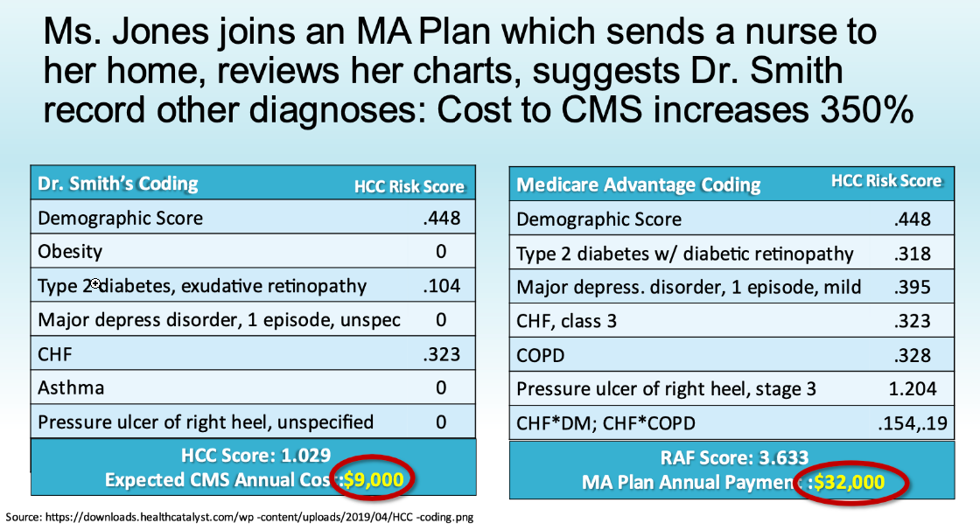

Slide 64
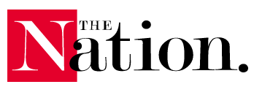
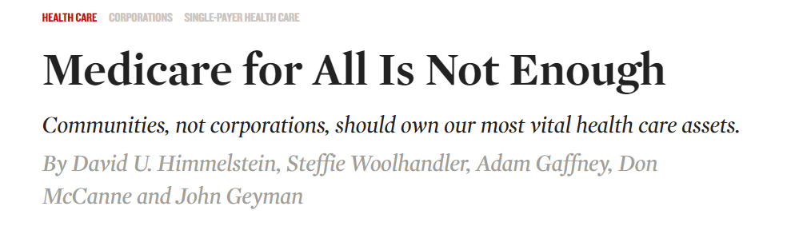




Slide 65
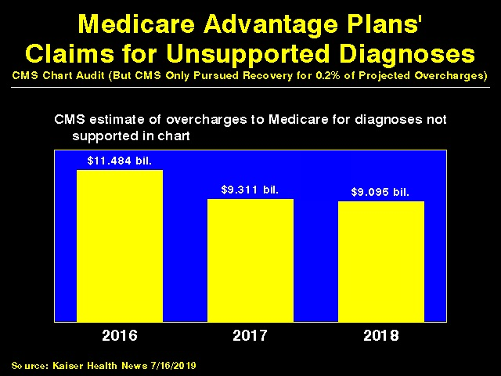

Slide 66
The ACA:
A Complex and Expensive Way to Expand Coverage

Slide 67


Slide 68

Medicare’s “Software”
18.9 Million Seniors Enrolled Within11 Months

Slide 69


Slide 70


Slide 71
American Taxpayers Already Pay More Than People in Nations With National Health Insurance

Slide 72


Slide 73
U.S. Health Care:
Higher Costs, Worse Outcomes, Less Care

Slide 74


Slide 75


Slide 76


Slide 77


Slide 78


Slide 79
Canada’s Single Payer National Health Insurance Program

Slide 80


Slide 81


Slide 82


Slide 83


Slide 84


Slide 85
How Canada Controls Costs
Low administrative costs - 16.7% of health spending vs. 31.0% in U.S.
Lump-sum, global budgets for hospitals
Stringent controls on capital spending for new buildings and equipment
Single buyer purchasing reins in drug/device prices
Low litigation and malpractice costs
Emphasis on primary care
Exclusion of private insurers
Source: Himmelstein & Woolhandler, Arch Intern Med, December, 2012

Slide 86


Slide 87


Slide 88


Slide 89


Slide 90


Slide 91


Slide 92


Slide 93


Slide 94
Medicare for All Enjoys Wide Support

Slide 95


Slide 96


Slide 97


Slide 98
A National Health Program for the U.S.

Slide 99


Slide 100


Slide 101


Slide 102
Global Operating Budgets:
Key to Single Payer Savings
Cuts hospital administrative costs.
Eliminates disparities in profitability of patients.
Banning hospitals from keeping surplus minimizes entrepreneurial incentives.
Funding capital through explicit grants minimizes unneeded duplication of expensive services.

Slide 103
Prescription Drugs and Single Payer
Full coverage, no deductibles/copays.
Prices reduced by negotiations, national formulary, threat of patent revocation.
Funding for public drug development, testing, and (when necessary) manufacture.
Raise standards and FDA funding for drug approval, marketing and post-approval surveillance.
Eliminate tax deductions for advertising; prohibit pharma-funded CME and guideline development.
Source: Gaffney, Lexchin, Angell, Carome et al. BMJ 2018;361:K1039

Slide 104
Single Payer Transition:
For Displaced Clerical and Administrative Workers
All 400,000 health insurance workers and about ½ of the 2.6 mil. clerical/administrative employees in healthcare providers likely to be displaced – total 1.7 million.
Many likely to be redeployed in expanded clinical workforce.
Funding for income support and job retraining modeled on WWII GI Bill.

Slide 105
Single Payer Transition:
For Patients
Every U.S. resident receives an insurance card.
Full coverage for all medically necessary care, no copayments, deductibles or coinsurance.
Prescription drug formulary, with alternatives covered when medically indicated
Free choice of any participating provider or hospital.

Slide 106
Medicare for All vs.
Medicare for More
(e.g. Public Option)

Slide 107
Single Payer and Private Coverage
Allowed: Supplemental non-competing –but can only cover benefits NOT covered by the public plan.
Banned:: Private insurance (including Medicare Advantage) duplicating public plan benefits – Key to administrative savings.

Slide 108
Public Option = High Costs
Less savings than single payer on insurers’ overhead
Multiple payers = no savings on doctor/hospital billing and administration.
Private insurers will tilt the playing field (as under Medicare Advantage) raising system-wide costs and perpetuating network restrictions, cherry-picking, lemon dropping, upcoding, cheating.
Higher system-wide costs (compared to single payer) assure political pressure for benefit cuts.

Slide 109


