Slide 1

Slides prepared by Drs. Steffie Woolhandler & David Himmelstein, Faculty at the City University of New York at Hunter College and Harvard Medical School, and Research Associates, Public Citizen Health Research Group

Slide 2
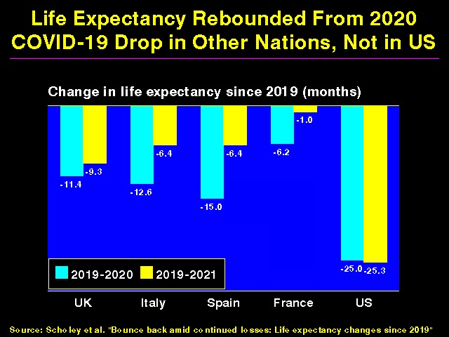

Slide 3
Why was the U.S. so Vulnerable to COVID-19?
Deteriorating health status.
Weakened public health capacity.
Increasing economic inequality.
Racism that harms people of color and erodes support for safety-net programs.
Wasteful health care system that prioritizes profitability over needs.

Slide 4
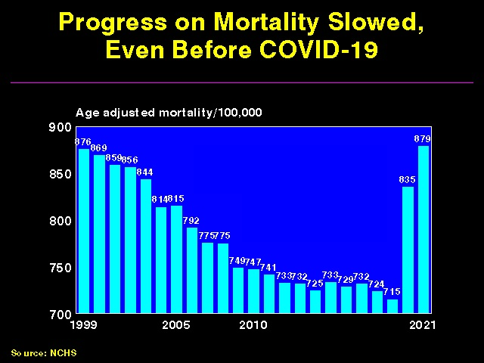

Slide 5
Life expectancy in the US and other G7 countries, 1960–2018
Source: J. Bor based on OECD 2020

Slide 6
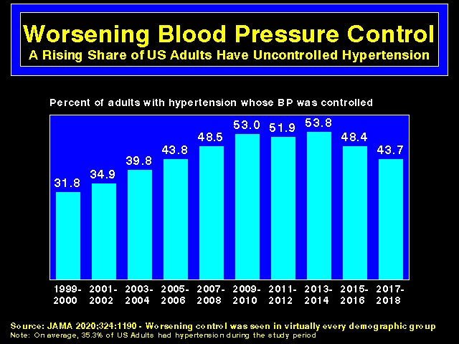

Slide 7
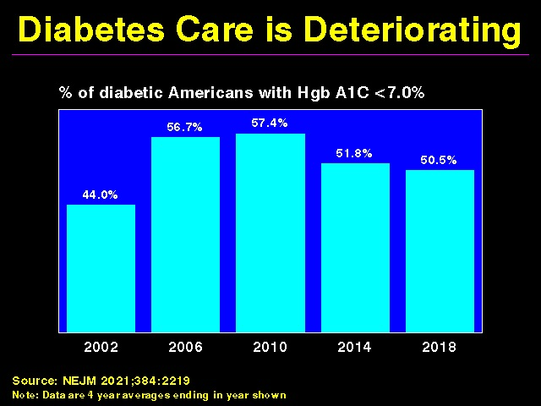

Slide 8
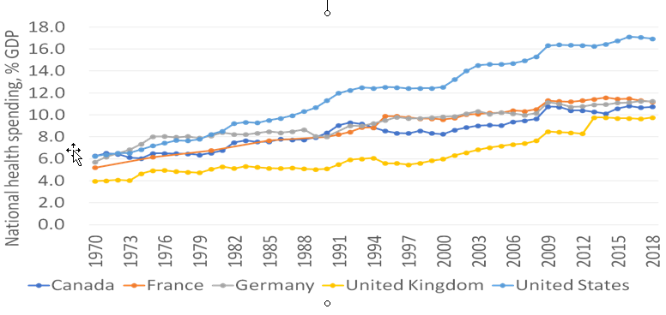
US Health Expenditures Started Diverging from Other Nations’ ~1980
Source: A. Gaffney based on OECD data, 2020

Slide 9
Why Did US Longevity Stall and Health Costs Soar Starting in ~ 1980?

Slide 10

Neoliberalism
(AKA Market Fundamentalism)
Markets regulate themselves
They give everyone what they deserve
Unions distort markets, impede formation of
merit-based hierarchy
Government is incompetent
Taxes and regulation should be cut
Public services should be privatized
Seeking equality is counterproductive and morally
corrosive
Background photo from The American Prospect

Slide 11
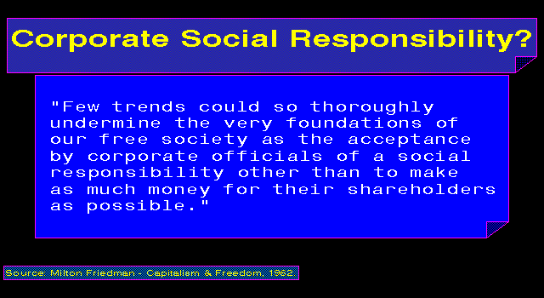
Notes:
11
11

Slide 12
“The most terrifying words in the English language are: ‘I’m from the government and I’m here to help’ ” Ronald Reagan
Many Democrats Joined the
Neoliberal Bandwagon
“The era of big government is over”
Bill Clinton

Slide 13
Weakened Public Health Capacity

Slide 14
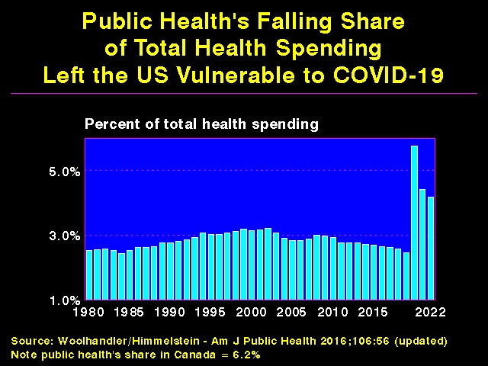

Slide 15
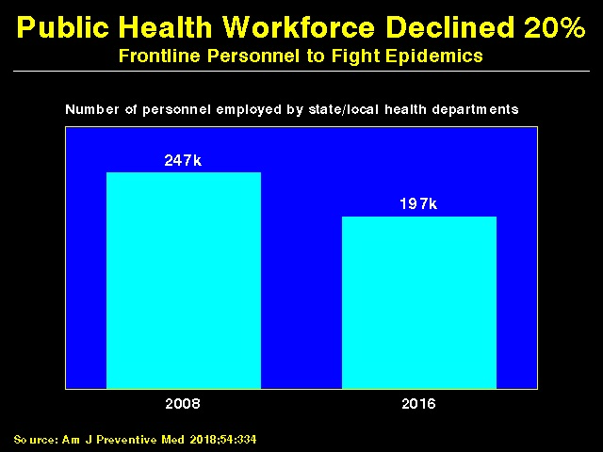

Slide 16
Increasing Economic Inequality

Slide 17
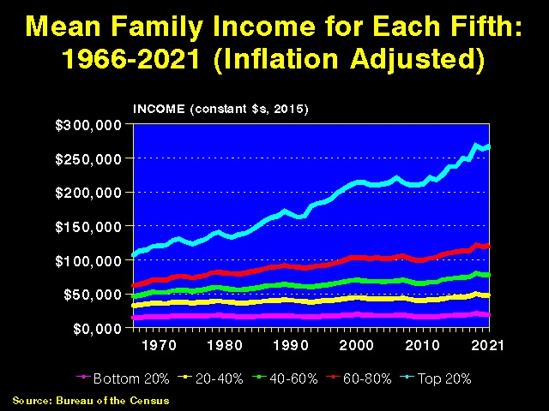

Slide 18
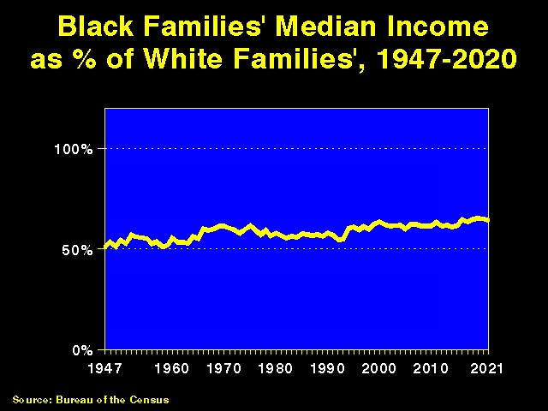

Slide 19
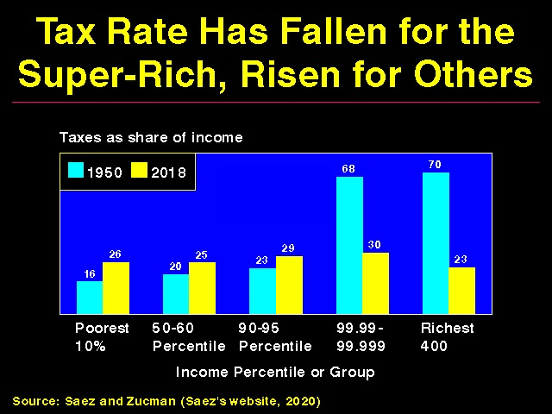

Slide 20
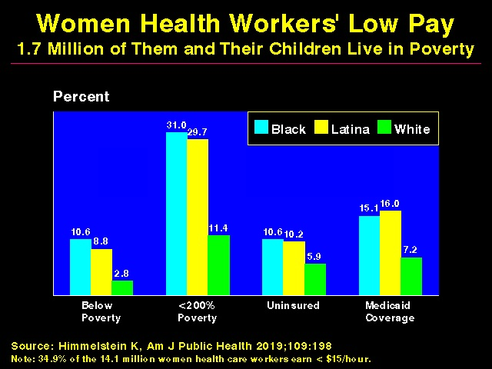

Slide 21
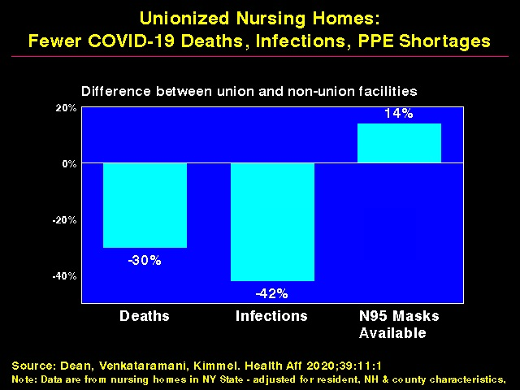

Slide 22
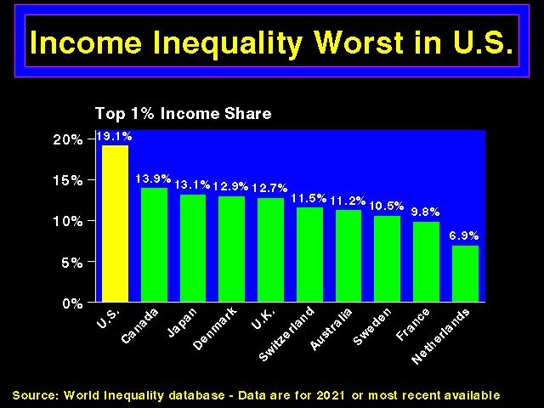

Slide 23
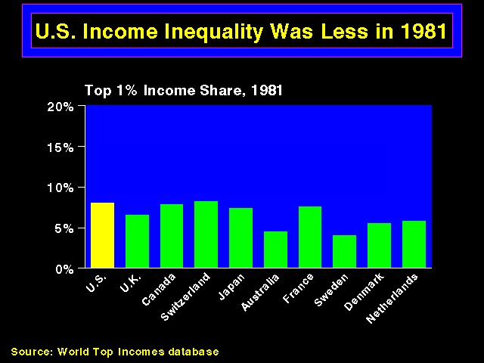

Slide 24
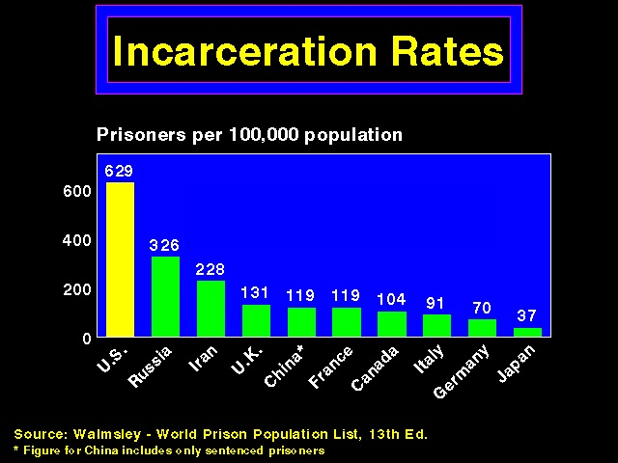

Slide 25

Prisoners Face Copays for Care
42 states + federal prison system charge copays for a visit.
Average copay = $3.47/visit.
In Oklahoma, prisoners earning 5 cents/hr. face a $4 copay (80 hours of work income, equivalent to $580 for a minimum wage workers.)
Source: The Marshall Project, May 30, 2018

Slide 26
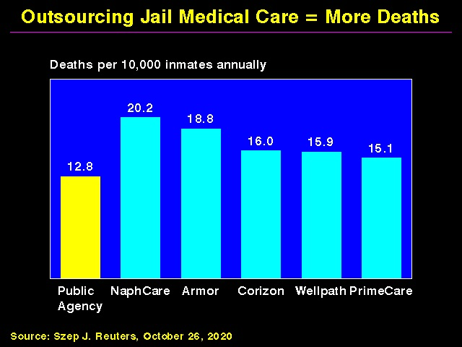

Slide 27
Increasing Economic Inequality Harms Health

Slide 28
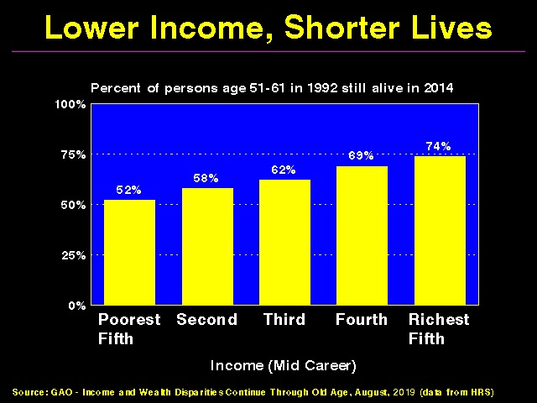

Slide 29
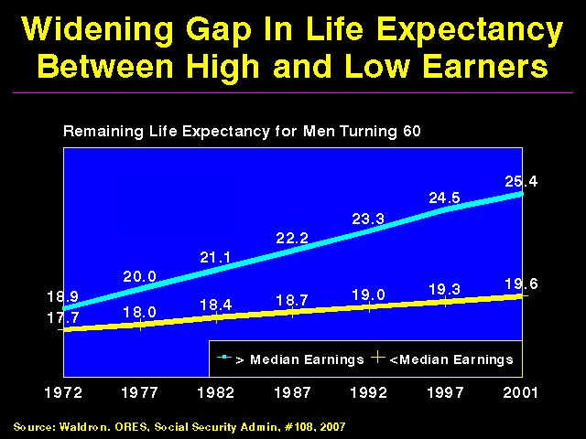

Slide 30
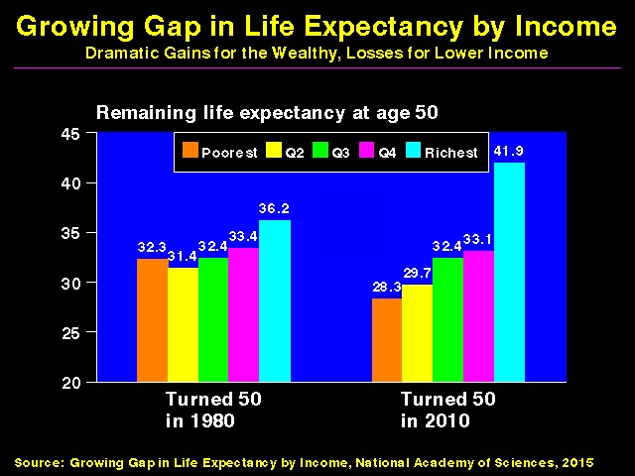

Slide 31
The Uninsured

Slide 32
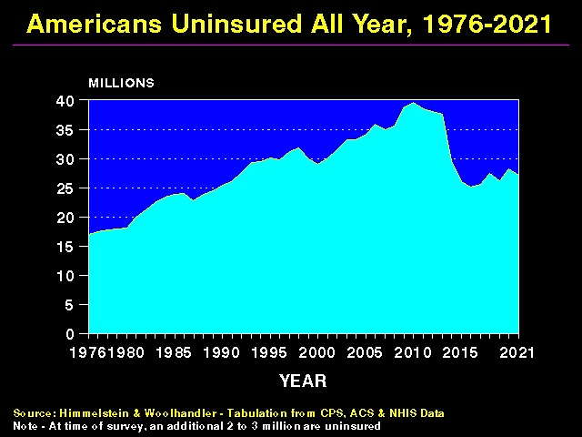

Slide 33
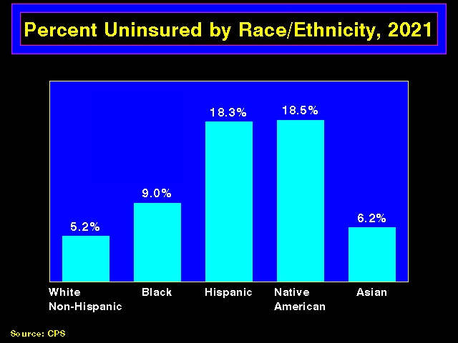

Slide 34
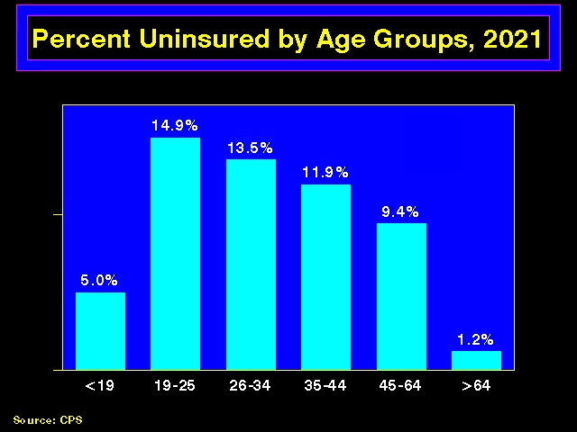

Slide 35
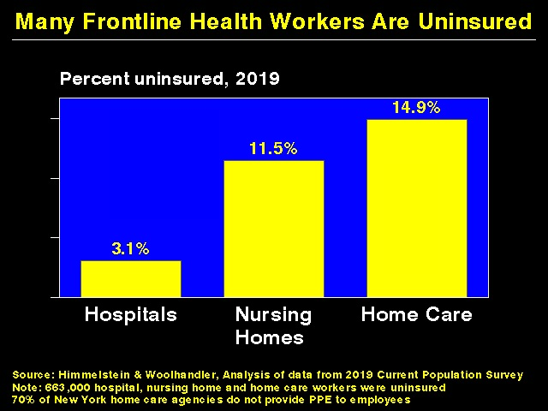

Slide 36
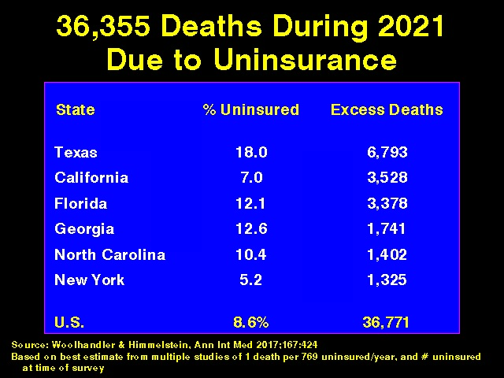

Slide 37
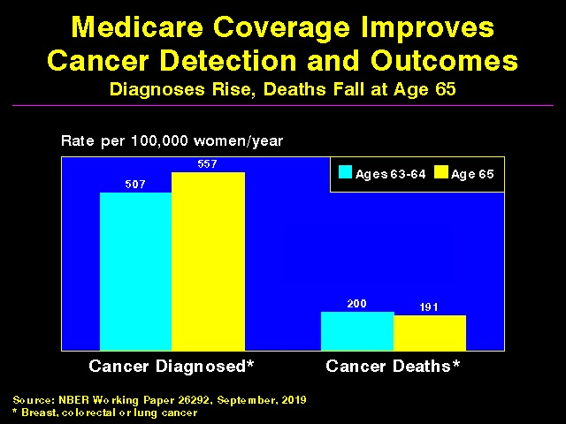

Slide 38
Medicaid: Poor Access, But Better Than Nothing

Slide 39
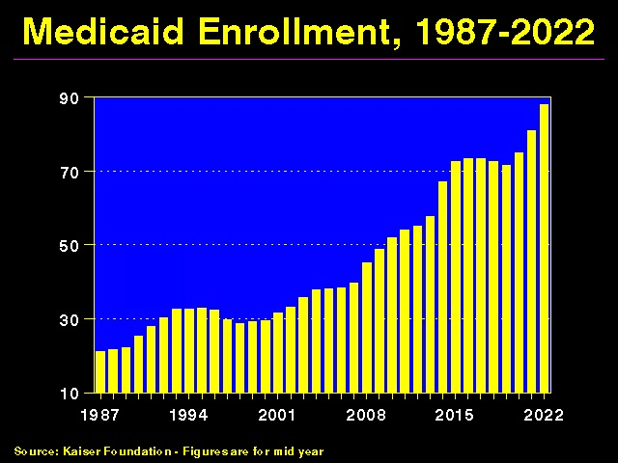

Slide 40
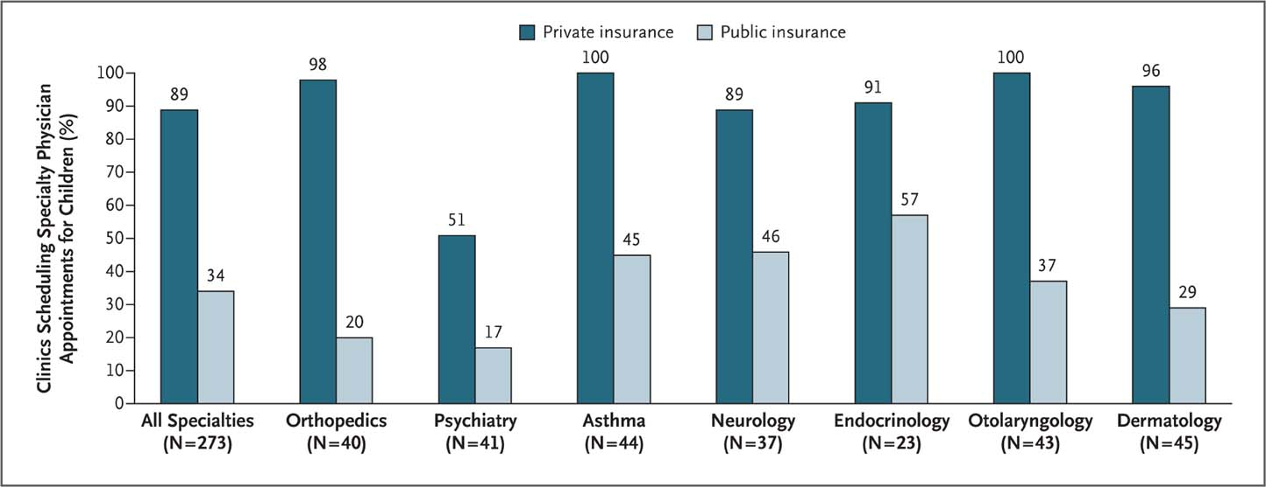
Many Specialists Won’t See Kids With Medicaid
Bisgaier J, Rhodes KV. N Engl J Med 2011;364:2324-2333
Notes:
Figure 2 Clinics Scheduling Specialty Care Appointments for Children, According to Type of Insurance. Public insurance was reported by callers as the Illinois Medicaid–Children's Health Insurance Program (CHIP) umbrella program; private insurance was reported by callers as Blue Cross Blue Shield. Each of the 273 clinics was called twice (for a total of 546 calls) by the same caller, with only insurance coverage varying between the two calls: once reporting Medicaid–CHIP coverage and once reporting private coverage. Calls were made 1 month apart, and the order of the reported insurance status was randomly assigned. Asthma clinics included 38 allergy–immunology clinics and 6 pulmonary disease clinics.

Slide 41
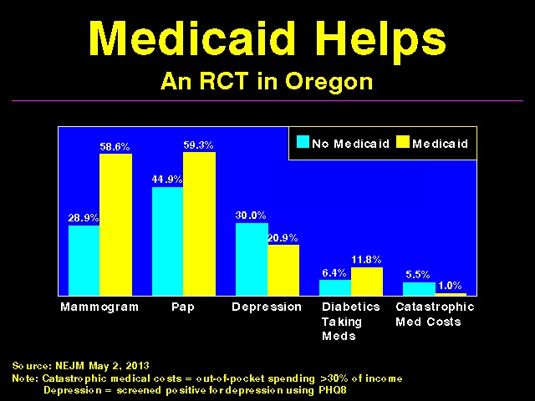

Slide 42
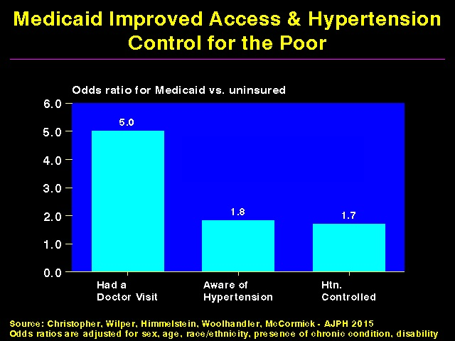

Slide 43
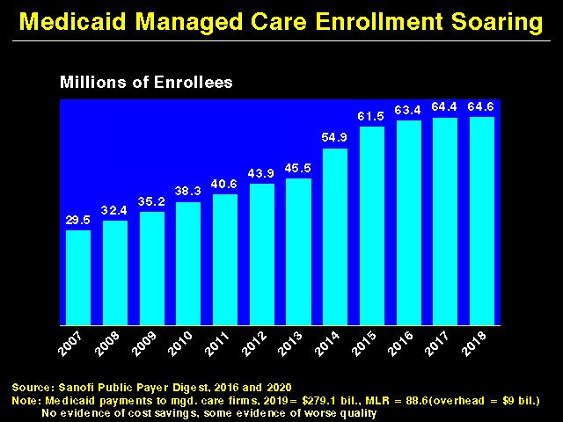

Slide 44
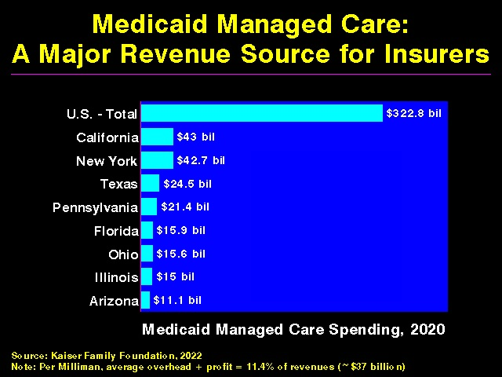

Slide 45
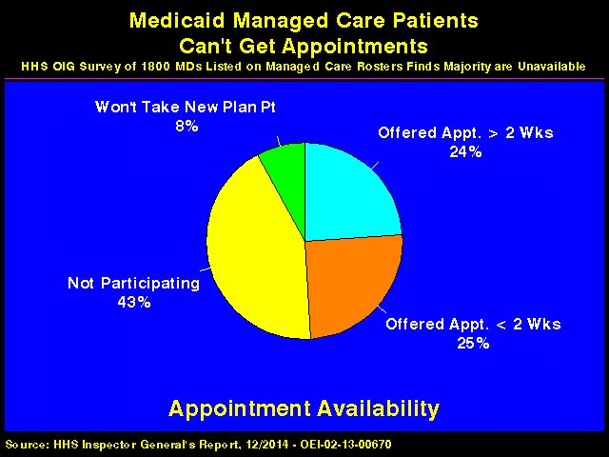

Slide 46
Under-Insurance

Slide 47
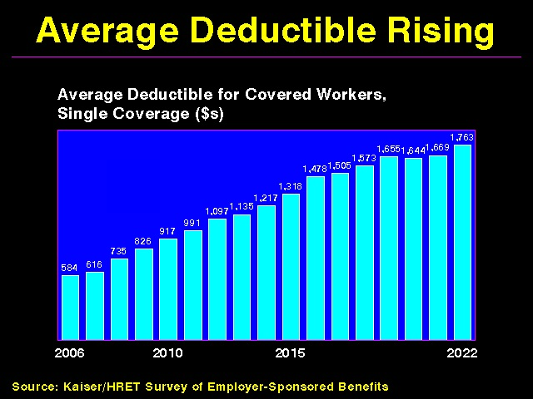

Slide 48
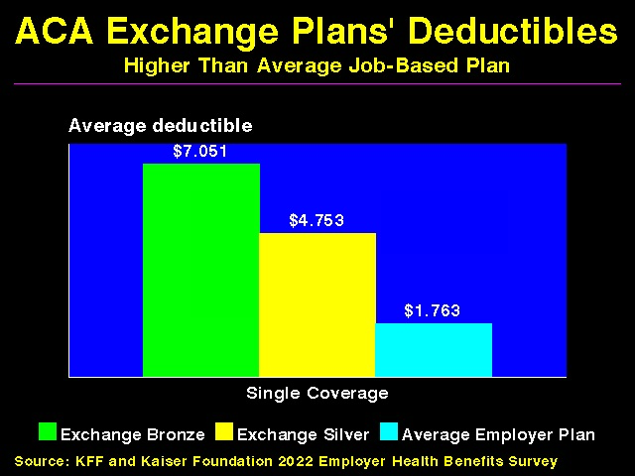

Slide 49
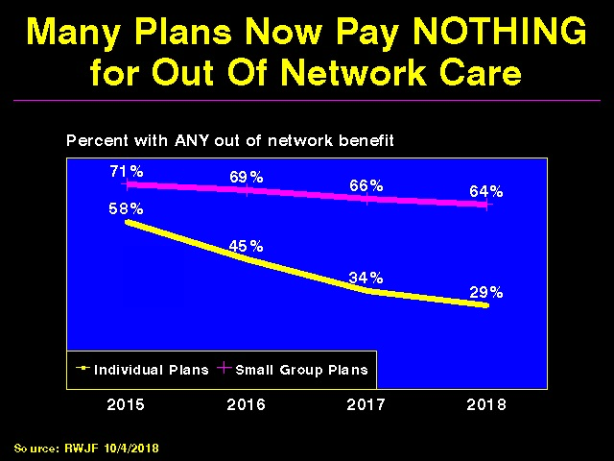

Slide 50
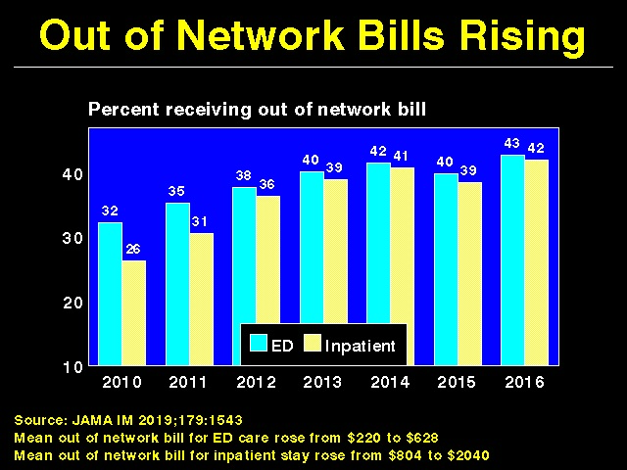

Slide 51
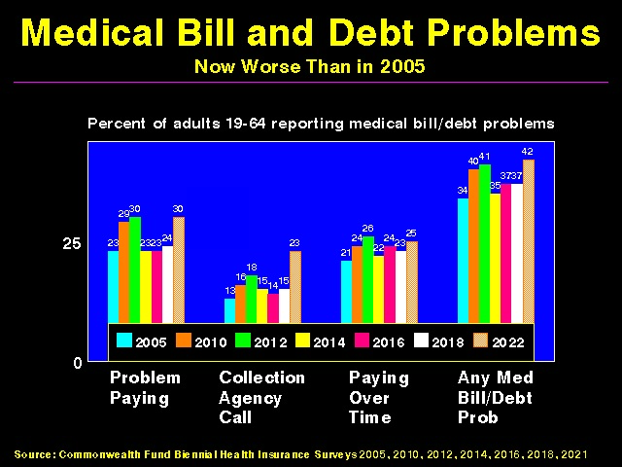

Slide 52
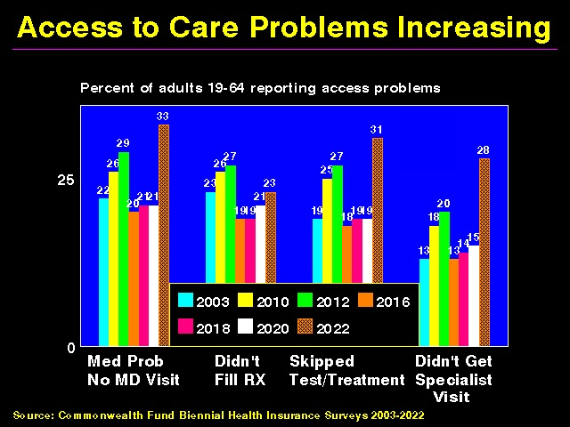

Slide 53
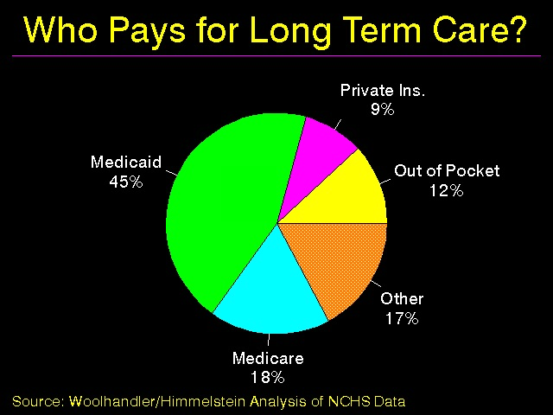

Slide 54
Under-Insurance Impedes Care, Worsens Health

Slide 55
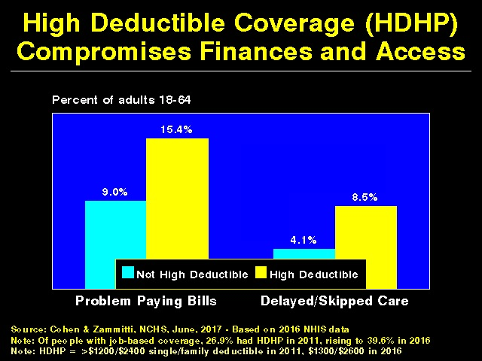

Slide 56
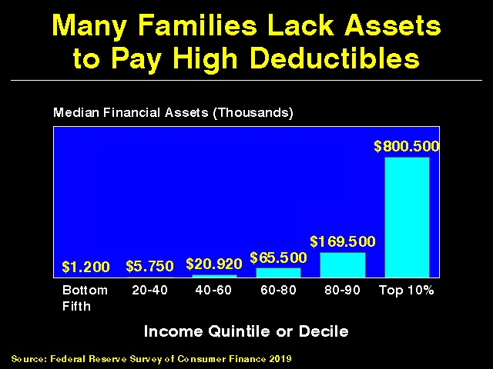

Slide 57
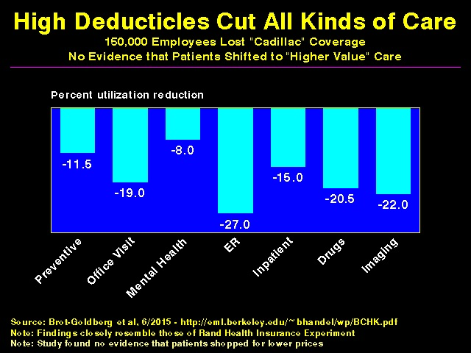

Slide 58
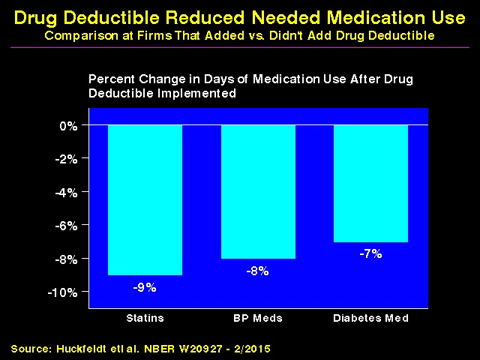

Slide 59
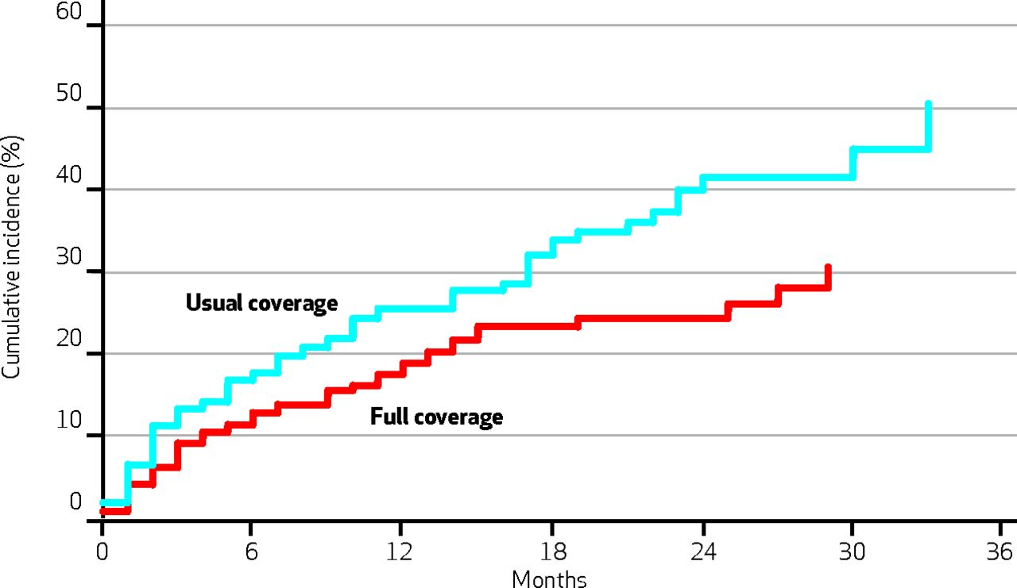
Medication Co-pays Increased Post-MI Vascular Events in Minorities – An RCT
Co-Pay Group
Free Med Group
Source: Health Aff 2014:33:863

Slide 60
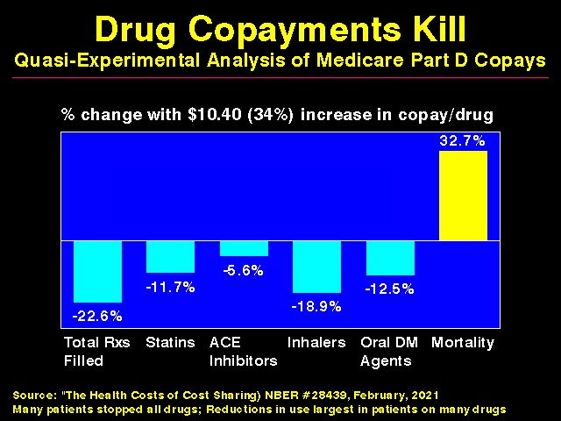

Slide 61
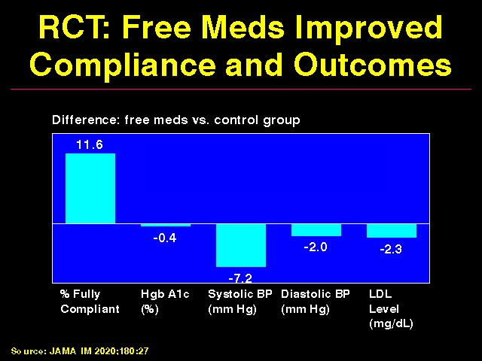

Slide 62
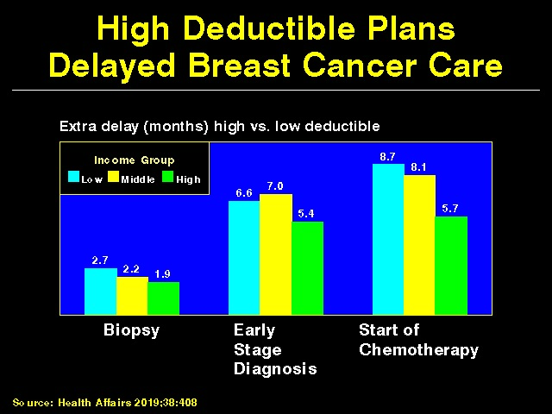

Slide 63
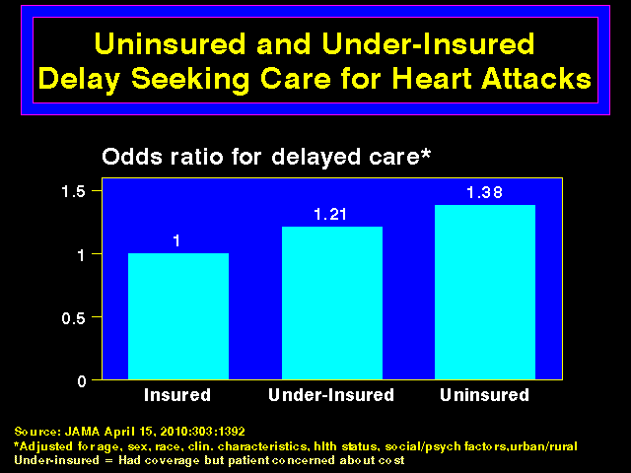

Slide 64
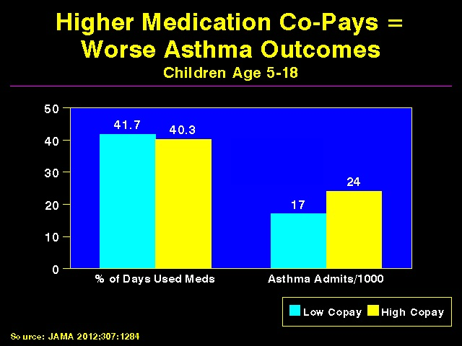

Slide 65


Slide 66
Under-Insurance: A Leading Cause of Financial Distress and Ruin

Slide 67


Slide 68


Slide 69


Slide 70


Slide 71


Slide 72


Slide 73


Slide 74


Slide 75
Racism Harms Health

Slide 76


Slide 77

Native Americans Die Youngest
Asian
Life
Expectancy
Hispanic
White
US Total
Black
American Indian/Alaska Native
Source: Lancet 2022;400:25

Slide 78


Slide 79


Slide 80


Slide 81


Slide 82


Slide 83


Slide 84


Slide 85


Slide 86


Slide 87


Slide 88


Slide 89


Slide 90


Slide 91


Slide 92


Slide 93


Slide 94


Slide 95


Slide 96


Slide 97


Slide 98


Slide 99
Protecting Immigrants’ Right to Health Care

Slide 100


Slide 101


Slide 102


Slide 103


Slide 104


Slide 105


Slide 106


Slide 107
While Many Go Without Vital Services, Others Get Low- or No-Value Care

Slide 108


Slide 109


Slide 110


Slide 111
Administrative Overhead Rising

Slide 112


Slide 113


Slide 114

EPIC EHR Notes 4x Longer in US Documentation Driven by Payment Complexity
Source: Ann Intern Med 2018; 169:51

Slide 115
Investor-Owned Care: Inflated Costs, Inferior Quality

Slide 116


Slide 117


Slide 118


Slide 119


Slide 120


Slide 121


Slide 122


Slide 123

For-Profit Hospitals Cost 19% More
Source: CMAJ 2004;170:1817
Notes:
123

Slide 124


Slide 125


Slide 126


Slide 127


Slide 128


Slide 129
FFor-Profit Dialysis Clinics’ Death Rates are 7% Higher
3800 Excess Death Annually
Source: Dickman, Mirza et al. Int J Health Serv 2021;51:371

Slide 130


Slide 131


Slide 132


Slide 133


Slide 134


Slide 135


Slide 136


Slide 137


Slide 138


Slide 139


Slide 140


Slide 141


Slide 142


Slide 143


Slide 144


Slide 145
What Happens When PE Buys a Dermatology Practice?
Push sales of cosmeceuticals.
Offer bonuses for increasing elective procedures (and continued elective procedures throughout pandemic).
Pushed MDs to increase (e.g. double) visit #s.
Mobile clinicians do frequent skin check and biopsies on demented nursing homes patients.
Bring dermatopathology services “in house”, increasing biopsy rates and likely false positive melanoma Dxs.
Extensive use of poorly-supervised PAs and NPs for skin checks and procedures.
Skimp on supplies.
Increase Medicare billings/taxpayer costs.
Sources: Bloomberg Law 5/20/2020; NBC News 12/20/2021; NY Times 10/26/2018 & 11/20/2017

Slide 146


Slide 147


Slide 148
Drug and Device Firms Inflate Prices, Distort Priorities

Slide 149


Slide 150


Slide 151


Slide 152


Slide 153


Slide 154


Slide 155

Drug Companies’ Cost Structure

Slide 156


Slide 157


Slide 158

“The success of its [Gilead’s] hepatitis C franchise has gradually exhausted the available pool of treatable patients. . .In the case of infectious diseases such as hepatitis C, curing existing patients also decreases the number of carriers able to transmit the virus to new patients.”

Slide 159


Slide 160


Slide 161
Government Paid Twice for Vaccines
Funded most of the basic science research underlying mRNA vaccines and that characterized the spike protein.
Spent at least $18 billion subsidizing vaccine makers’ research and production, purchased all doses used in US.
Firms refused to share vaccine recipe, limiting global production capacity and leaving billions unprotected.
Cost to manufacture mRNA vaccine: ~$2/dose for Moderna, ~$1/dose for Pfizer. Sale price ~$25/dose. (J Royal Soc Med 2021;114:502)
“Pfizer, BioNTech and Moderna will make pre-tax profits of $34 billion this year between them, which works out as over a thousand dollars a second.” (Peoples Vaccine Alliance)

Slide 162


Slide 163
Private Insurers: Middlemen Who Add Costs But Not Value

Slide 164


Slide 165


Slide 166


Slide 167


Slide 168


Slide 169


Slide 170


Slide 171


Slide 172
Medicare Advantage: The Only Working Model of Competing Private Plans and a Public Option (Traditional, FFS Medicare)

Slide 173


Slide 174


Slide 175


Slide 176
How do Medicare Advantage Plans Outcompete Traditional Medicare?
Cherry-picking + Lemon-dropping
Exclude hospitals/doctors attractive to high-cost patients
Benefit/formulary design
Hassle factor
Upcode + over-diagnose to game risk adjustment
Outright cheating

Slide 177


Slide 178

Medicare Advantage Plans’ Strategies: 1- Cherry Picking
Marketing, network manipulation, benefit design

Slide 179


Slide 180

Medicare Advantage Plans’ Strategies: 2 - Lemon Dropping
Network manipulation, benefit design, hassle factor

Slide 181


Slide 182


Slide 183


Slide 184


Slide 185


Slide 186


Slide 187


Slide 188


Slide 189


Slide 190

Medicare Advantage Plans’ Strategies: 3 - Cheating

Slide 191


Slide 192


Slide 193


Slide 194


Slide 195
HMO “Housecalls” A New Upcoding Scam
HMOs send it “housecall” doctor – or one from Mobile Medical Examination Services Inc.
Doctor seeks out unimportant diagnoses, e.g. mild arthritis
No treatment offered
Extra diagnoses allow HMOs to upcode - adding > $3 billion/yr to Medicare Advantage payments
Efforts to outlaw upcoding “housecalls” were scrapped after industry lobbying blitz
Source: Schulte, Center for Public Integrity, 2014

Slide 196
Profit-Driven Upcoding Makes Accurate Risk Adjustment Impossible: High Cost Providers Inflate Both Reimbursement and Quality Scores by Making Patients Look Sicker on Paper

Slide 197


Slide 198


Slide 199


Slide 200


Slide 201


Slide 202


Slide 203


ACOs Warmed Over Managed Care

Slide 204


Slide 205


Slide 206


Slide 207


Slide 208


Slide 209


Slide 210
McKinsey: “The Math of ACOs”
~$9 million/year/ACA spent on new data/analytics
~1.25% of total revenues for care management: Success depends on curtailing patients’ use of care and steering enrollees to lower-price providers, NOT managing chronic conditions.
Additional costs for “executive director, head of real estate, head of care management, and lawyers and actuaries”
Source: McKinsey & Co.. August 2020

Slide 211


Slide 212
Failure of Medicare HMO Risk Adjustment: Implications for ACOs
Despite decades-long effort, CMS has failed to stop cherry-picking
Intensive coding makes patients appear sicker on paper, ups risk-adjusted capitation fee and factitiously raises quality scores
ACOs that fail to cherry pick/upcode get low payments, and factitiously poor quality scores
Implications:
No net savings, probable increased costs
Resources transferred from sick to healthy
Biggest cheaters are biggest winners
ACOs that embrace problem patients driven from the market

Slide 213
The Toxicity of Pay for Performance (P4P)

Slide 214
Assumptions Implicit in P-4-P
Performance can be accurately ascertained
Individual variation is caused by variation in motivation
Financial incentives will add to intrinsic motivation
Current payment system is too simple
Hospitals/MDs delivering poor quality care should get fewer resources

Slide 215


Slide 216


Slide 217


Slide 218
Pay for Performance
“I do not think its true that the way to get better doctoring and better nursing is to put money on the table in front of doctors and nurses. I think that's a fundamental misunderstanding of human motivation. I think people respond to joy and work and love and achievement and learning and appreciation and gratitude - and a sense of a job well done. I think that it feels good to be a doctor and better to be a better doctor. When we begin to attach dollar amounts to throughputs and to individual pay we are playing with fire. The first and most important effect of that may be to begin to dissociate people from their work.”
Don Berwick, M.D,
Source: Health Affairs 1/12/2005

Slide 219


Slide 220


Slide 221


Slide 222


Slide 223

Most Value-Based Payment Programs Have Flopped:
Costs Exceed Savings
Net Losses
Savings
Source: NEJM 2021;384:759

Slide 224


Slide 225
ACOs and P4P: Implementation Without Evidence
P-4-P – Official Medicare policy, widely adopted by private payers
No RCTs showing improved outcomes.
No improvement in 3 largest programs.
Negative side effects likely, e.g. increased CHF deaths.
VA (no P4P) has better quality than hospitals paid P4P
ACOs – Newest health policy panacea
– No RCTs.
– No savings once bonuses factored in.
– Disturbing HMO experience.
Implementing everywhere interventions which have been proven nowhere risks failure on a colossal scale

Slide 226
Veterans Health Administration: Better and Fairer Care

Slide 227


Slide 228


Slide 229


Slide 230


Slide 231


Slide 232
Mandate Model Reform: Keeping Private Insurers In Charge

Slide 233




“Mandate” Model for Reform
Expanded Medicaid-like program
Free for poor
Subsidies for low income
Buy-in without subsidy for others
Employer Mandate +/- Individuals
Insurance Exchanges
Notes:
233

Slide 234


Slide 235

Medicare’s “Software” 18.9 Million Seniors Enrolled Within11 Months

Slide 236


Slide 237


Slide 238
American Taxpayers Already Pay More Than People in Nations With National Health Insurance

Slide 239


Slide 240


Slide 241


Slide 242
The U.S. Trails Other Nations om Health

Slide 243


Slide 244


Slide 245


Slide 246


Slide 247


Slide 248


Slide 249
High U.S. Costs Don’t Result From Bad Health Habits, Aging or Overuse of Care

Slide 250


Slide 251


Slide 252


Slide 253


Slide 254


Slide 255


Slide 256


Slide 257


Slide 258


Slide 259


Slide 260


Slide 261


Slide 262
Canada’s Single Payer National Health Insurance Program

Slide 263


Slide 264


Slide 265


Slide 266
Quality of Care Slightly Better in Canada Than U.S.
A Meta-Analysis of Patients Treated for Same Illnesses
(U.S. Studies Included Mostly Insured Patients)
Source: Guyatt et al, Open Medicine, April 19, 2007

Slide 267


Slide 268


Slide 269


Slide 270


Slide 271


Slide 272


Slide 273
How Canada Controls Costs
Low administrative costs - 16.7% of health spending vs. 31.0% in U.S.
Lump-sum, global budgets for hospitals
Stringent controls on capital spending for new buildings and equipment
Single buyer purchasing reins in drug/device prices
Low litigation and malpractice costs
Emphasis on primary care
Exclusion of private insurers
Source: Himmelstein & Woolhandler, Arch Intern Med, December, 2012

Slide 274


Slide 275


Slide 276


Hospital Financing: Medicare vs. Medicare
Per-patient payments
Capital and operating payments intermixed
New investments funded from surplus/profit
For-profits thrive
Global budget
Separate payment for capital
New investments funded by government grants
Eliminates opportunity for profitmaking

Slide 277

American Association of Professional Coders: 190,000 Members and Growing

Slide 278

Cleveland Clinic: 210 Million Prices
“Compounding the complexity, we have many different payers and multiple different products within each payer. Specifically we estimate that we have 3,000 contracted rate schedules across the Cleveland Clinic … system. Further, our chargemaster reflects over 70,000 lines …. Thus, the number of data points needed to be posted would exceed 210 million ….” Cleveland Clinic comment to CMS quoted in Modern Healthcare 9/30/2019

Slide 279

Duke Medical Center: 957 beds, 1600 billing clerks
Source: JAMA 2018;319:691
Notes:
Duke: 957 beds, 1,600 billing clerks

Slide 280


Slide 281
Duke’s costs to send bills for one PCP:
$99,000 annually
Source: JAMA 2018;319:691
Notes:
Duke: 957 beds, 1,600 billing clerks

Slide 282


Slide 283


Slide 284


Slide 285


Slide 286


Slide 287

Source: Modern Healthcare 4/ 7/ 2018
Source: Modern Healthcare 4/9/18

Slide 288

Source: Modern Healthcare 4/9/18
Source: Modern Healthcare 4/ 7/ 2018

Slide 289


Slide 290


Slide 291
Medicare for All Enjoys Wide Support

Slide 292


Slide 293


Slide 294

Polls: Consistent Support For M4A, Nov. 2015 – July 2020
Support
Oppose
Source: Kaiser Family Foundation, October, 2020

Slide 295


Slide 296


Slide 297
A National Health Program for the U.S.

Slide 298


Slide 299


Slide 300


Slide 301
Global Operating Budgets: Key to Single Payer Savings
Cuts hospital administrative costs.
Eliminates disparities in profitability of patients.
Banning hospitals from keeping surplus minimizes entrepreneurial incentives.
Funding capital through explicit grants minimizes unneeded duplication of expensive services.

Slide 302
Prescription Drugs and Single Payer
Full coverage, no deductibles/copays.
Prices reduced by negotiations, national formulary, threat of patent revocation.
Funding for public drug development, testing, and (when necessary) manufacture.
Raise standards and FDA funding for drug approval, marketing and post-approval surveillance.
Eliminate tax deductions for advertising; prohibit pharma-funded CME and guideline development.
Source: Gaffney, Lexchin, Angell, Carome et al. BMJ 2018;361:K1039

Slide 303


Current Senate and House Bills Strengths
Universal coverage, single public plan
Comprehensive acute care benefits
No copays for covered services
Bans duplicative private coverage
Exemption from Hyde Amendment
Drug formulary and price negotiations

Slide 304
Current Senate and House Bills Concerns
Both allow for-profit providers, with constraints
Senate bill: Adopts Medicare’s needlessly complex payment strategies, raising administrative burdens/costs and perpetuating incentives for upcoding etc., focusing on profitable services, etc.

Slide 305
Single Payer Transition: For Displaced Clerical and Administrative Workers
All 400,000 health insurance workers and about ½ of the 2.6 mil. clerical/administrative employees in healthcare providers likely to be displaced – total 1.7 million.
Many likely to be redeployed in expanded clinical workforce.
Funding for income support and job retraining modeled on WWII GI Bill.
Job displacement is common in the US – 60 million/year, including 20 million who are fired: 1.7 million = number who are fired every 31 days. (source: People’s Policy Report)

Slide 306


Slide 307
Single Payer Transition: For Patients
Every U.S. resident receives an insurance card.
Full coverage for all medically necessary care, no copayments, deductibles or coinsurance.
Prescription drug formulary, with alternatives covered when medically indicated
Free choice of any participating provider or hospital.

Slide 308
Medicare for All or Medicare for More?

Slide 309
Single Payer and Private Coverage
Allowed: Supplemental non-competing –but can only cover benefits NOT covered by the public plan.
Banned:: Private insurance (including Medicare Advantage) duplicating public plan benefits – Key to administrative savings.

Slide 310
Public Option Rhetoric
“Don’t strip 150 million Americans of their private insurance; let them choose”
“M4A means a giant tax increase”
“If public is better, it will outcompete private insurance”
“There’s lots of ways to get to universal care”

Slide 311


Slide 312
Transitioning to Germany
Non-profit sickness funds: boards ½ union, ½ employer.
All insurers pay same rates and include every doctor, every hospital.
States fund most hospital capital investment.
Single payer for long term care.

Slide 313
Transitioning to Switzerland
Mandatory coverage sold ONLY by non-profit insurers.
All insurers pay same rates and include every doctor, every hospital.
Cantons fund most hospital capital investment.
Only US has higher health costs.

Slide 314
Transitioning to Netherlands
Developed as German-style universal coverage.
Private insurers introduced 2006.
Doctors now complain of unbearable administrative burdens, and rupture of cooperation.
Hospital administrative costs 2nd only to US.
Single payer for long term care.

Slide 315
65% of Dutch GPs Sign Manifesto: “Everything Must Change”
“Insurers have too much power”
“Bureaucracy is growing”
Remove doctors from Competition Act* and make “cohesion through cooperation” the guiding principle in primary care
*Act forces each GPs to negotiate individual contract with insurers
Source: “Competition Hurts Healthcare: Doctors” NL Times 4/17/15

Slide 316
“Insurers in the Netherlands and Switzerland are not as a matter of public policy conceived of as private businesses and in important respects they are not allowed to function as private businesses. The Dutch and Swiss models--built on a uniform mandated benefit package, a limited menu of cost sharing, and provider rate regulation-- are not the models that private insurers in the United States are in fact advocating, but rather represent a quite different tradition based on social solidarity and not on market competition.”
“They have not, moreover, been successful in holding down costs or expanding access to insurance. Finally, their experience demonstrates again the tendency of insurers—even nonprofit insurers--to compete based on risk selection rather than cost, and the difficulty posed by trying to control this tendency through legal regulation.”
The Experience of Switzerland and the Netherlands with Individual Health Insurance Mandates: A Model for the United States? Timothy Stoltzfus Jost

Slide 317


Slide 318
Public Option = High Costs
Less savings than single payer on insurers’ overhead
Multiple payers = no savings on doctor/hospital billing and administration.
Private insurers will tilt the playing field (as under Medicare Advantage) raising system-wide costs and perpetuating network restrictions, cherry-picking, lemon dropping etc.
Higher system-wide costs (compared to single payer) assure political pressure for benefit cuts.

Slide 319
For Any Level of Spending, Single Payer Would Purchase More Care and Less Administration Than Public Option

Slide 320


Slide 321


Slide 322


Slide 323
Source: Cai et al, PLOS Medicine, 2020

Slide 324






Slide 325

“…There are no charges, except for a few special items”
“…no insurance qualifications”
An equal right to healthcare
Source: http://museum.hackney.gov.uk/object9232

